Slide 1
Course Management system project
Manage information about student, teacher, coordinator, and manager, also the system can support student, teacher, coordinator and manager to complete their tasks..

Slide 2
Group member
Duong Duc Huy ( Scrum Master, Product Owner, Tester)
Nguyen Tran Hung (Designer, Developer)
Do Minh Tu (DB Designer)
Bui Quang Tuan (Designer)

Slide 3
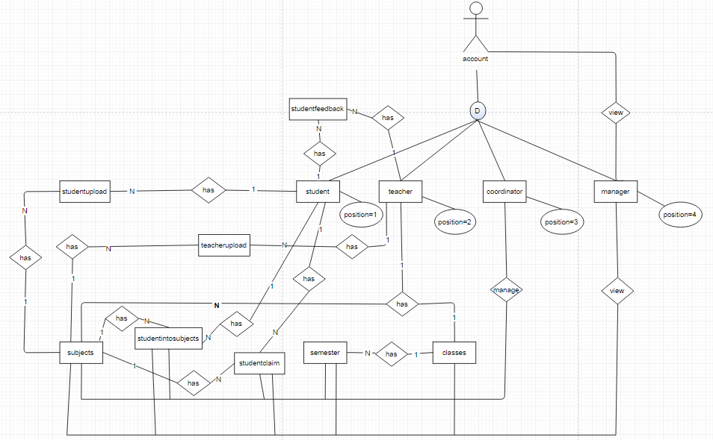
ER Diagrams design relational database

Slide 4
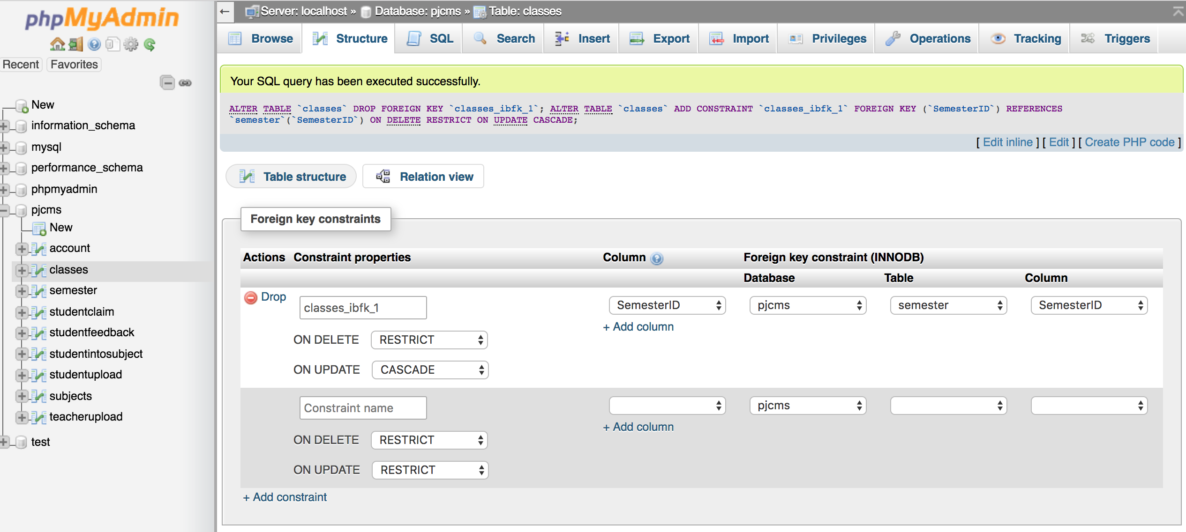
ER Diagrams design relational database
Implementation of referential integrity
Create constraint for data, between Primary key and Foreign key with ON DELETE ON UPDATE CASCADE

Slide 5
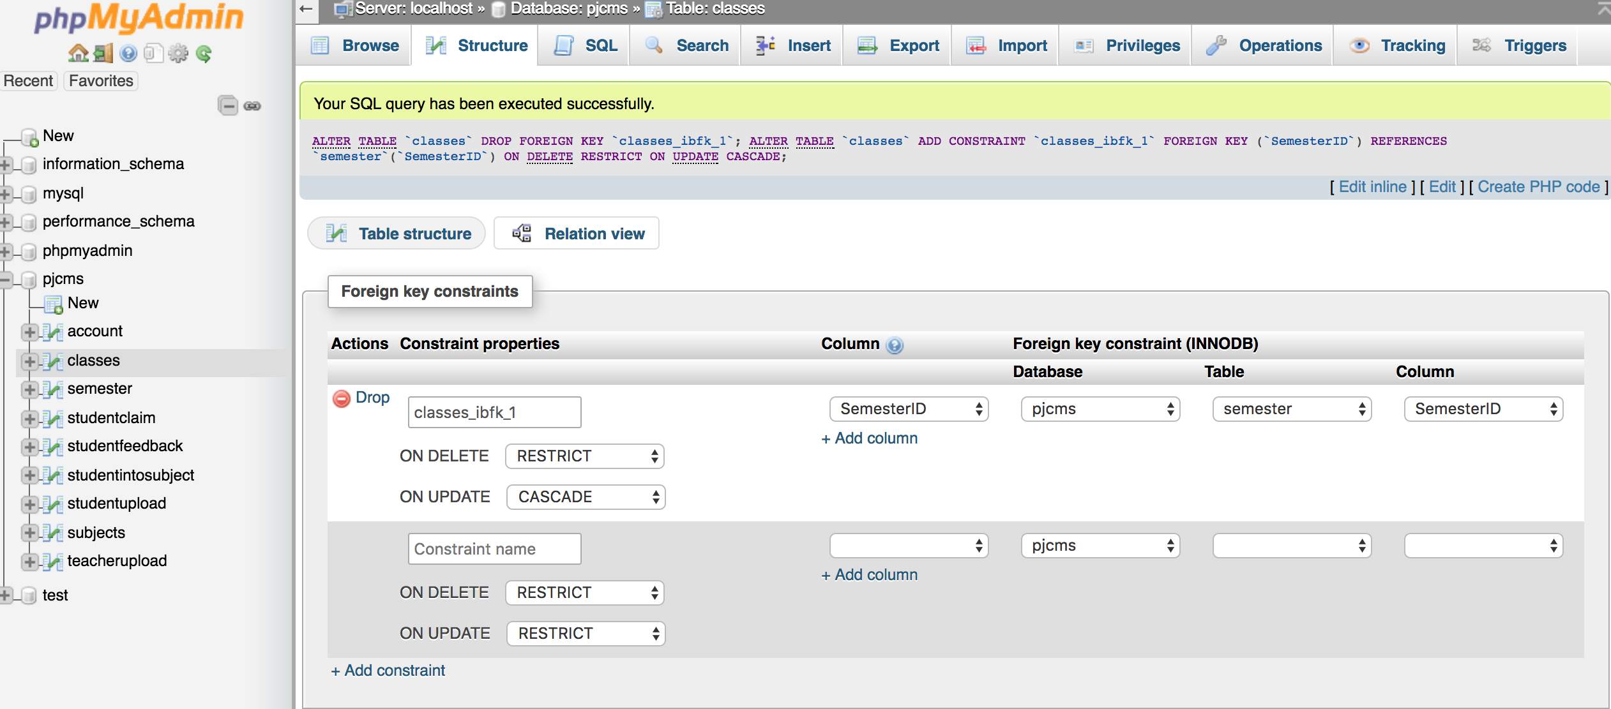
ER Diagrams design relational database
Implementation of referential integrity
Create constraint for data, between Primary key and Foreign key with ON DELETE ON UPDATE CASCADE

Slide 6
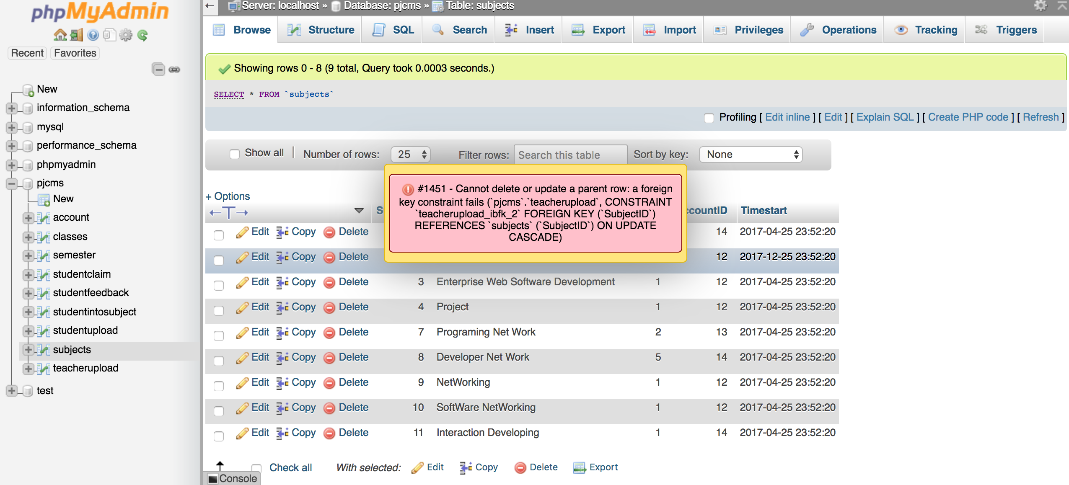
ER Diagrams design relational database
Implementation of referential integrity
Create constraint for data, between Primary key and Foreign key with ON DELETE ON UPDATE CASCADE

Slide 7
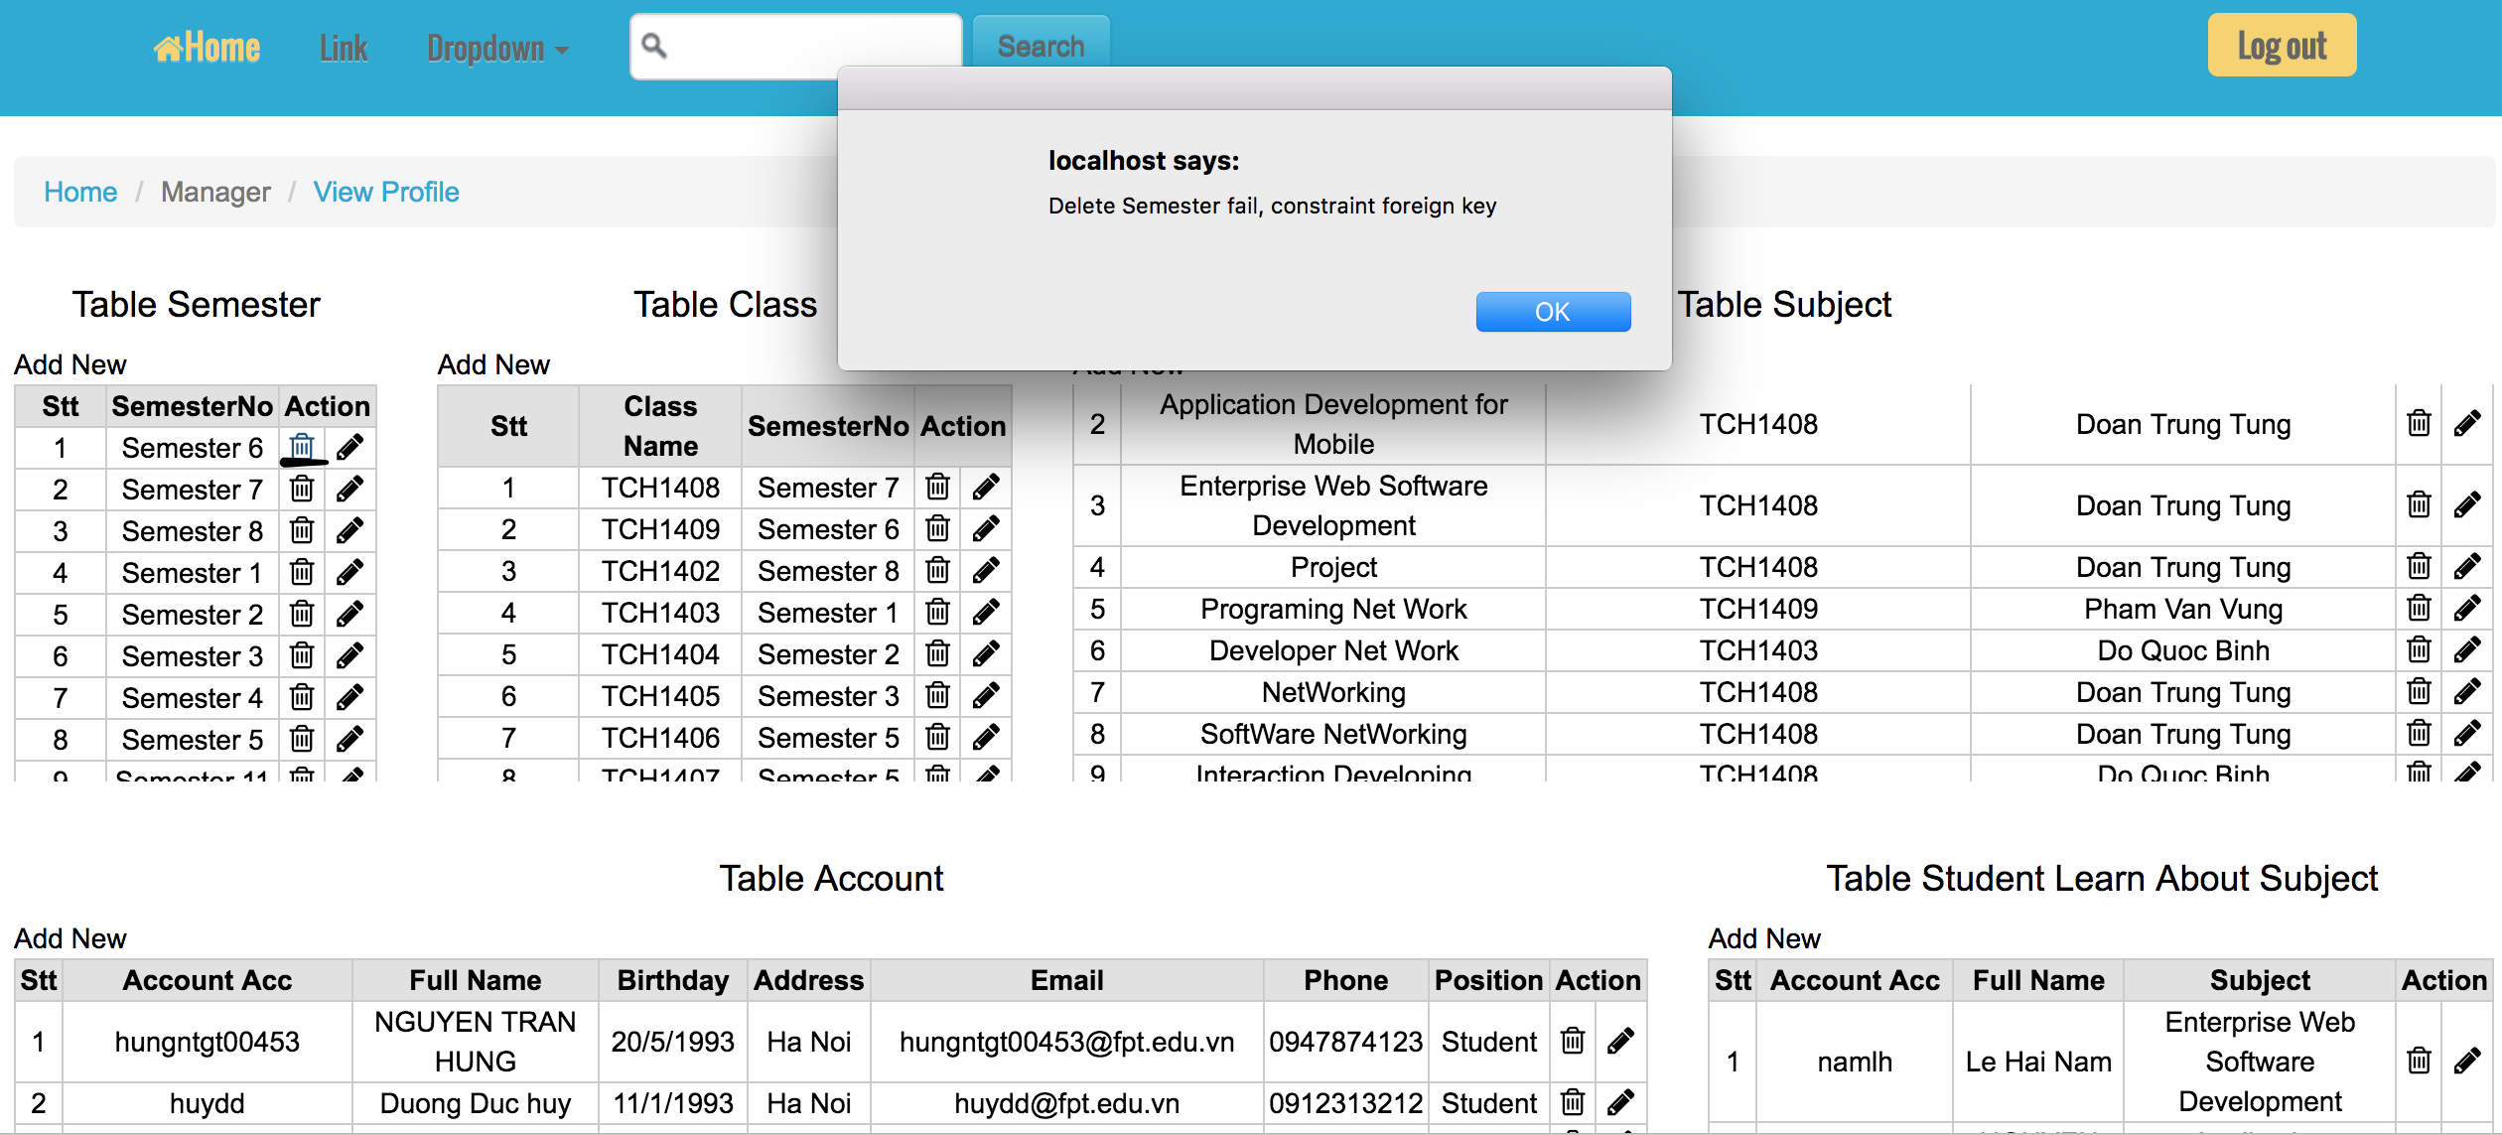
ER Diagrams design relational database
Implementation of referential integrity

Slide 8
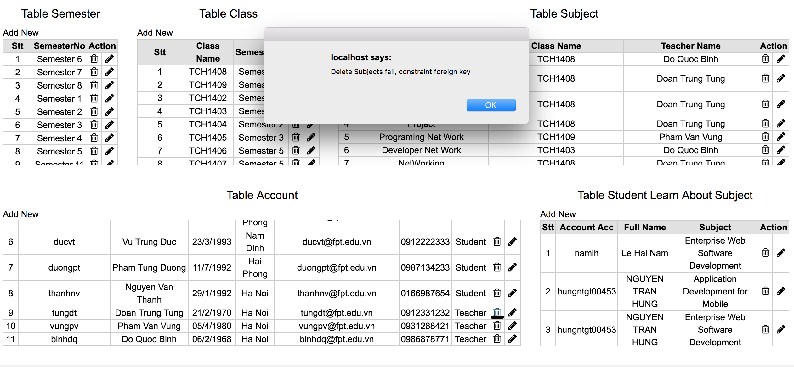
ER Diagrams design relational database
Implementation of referential integrity

Slide 9
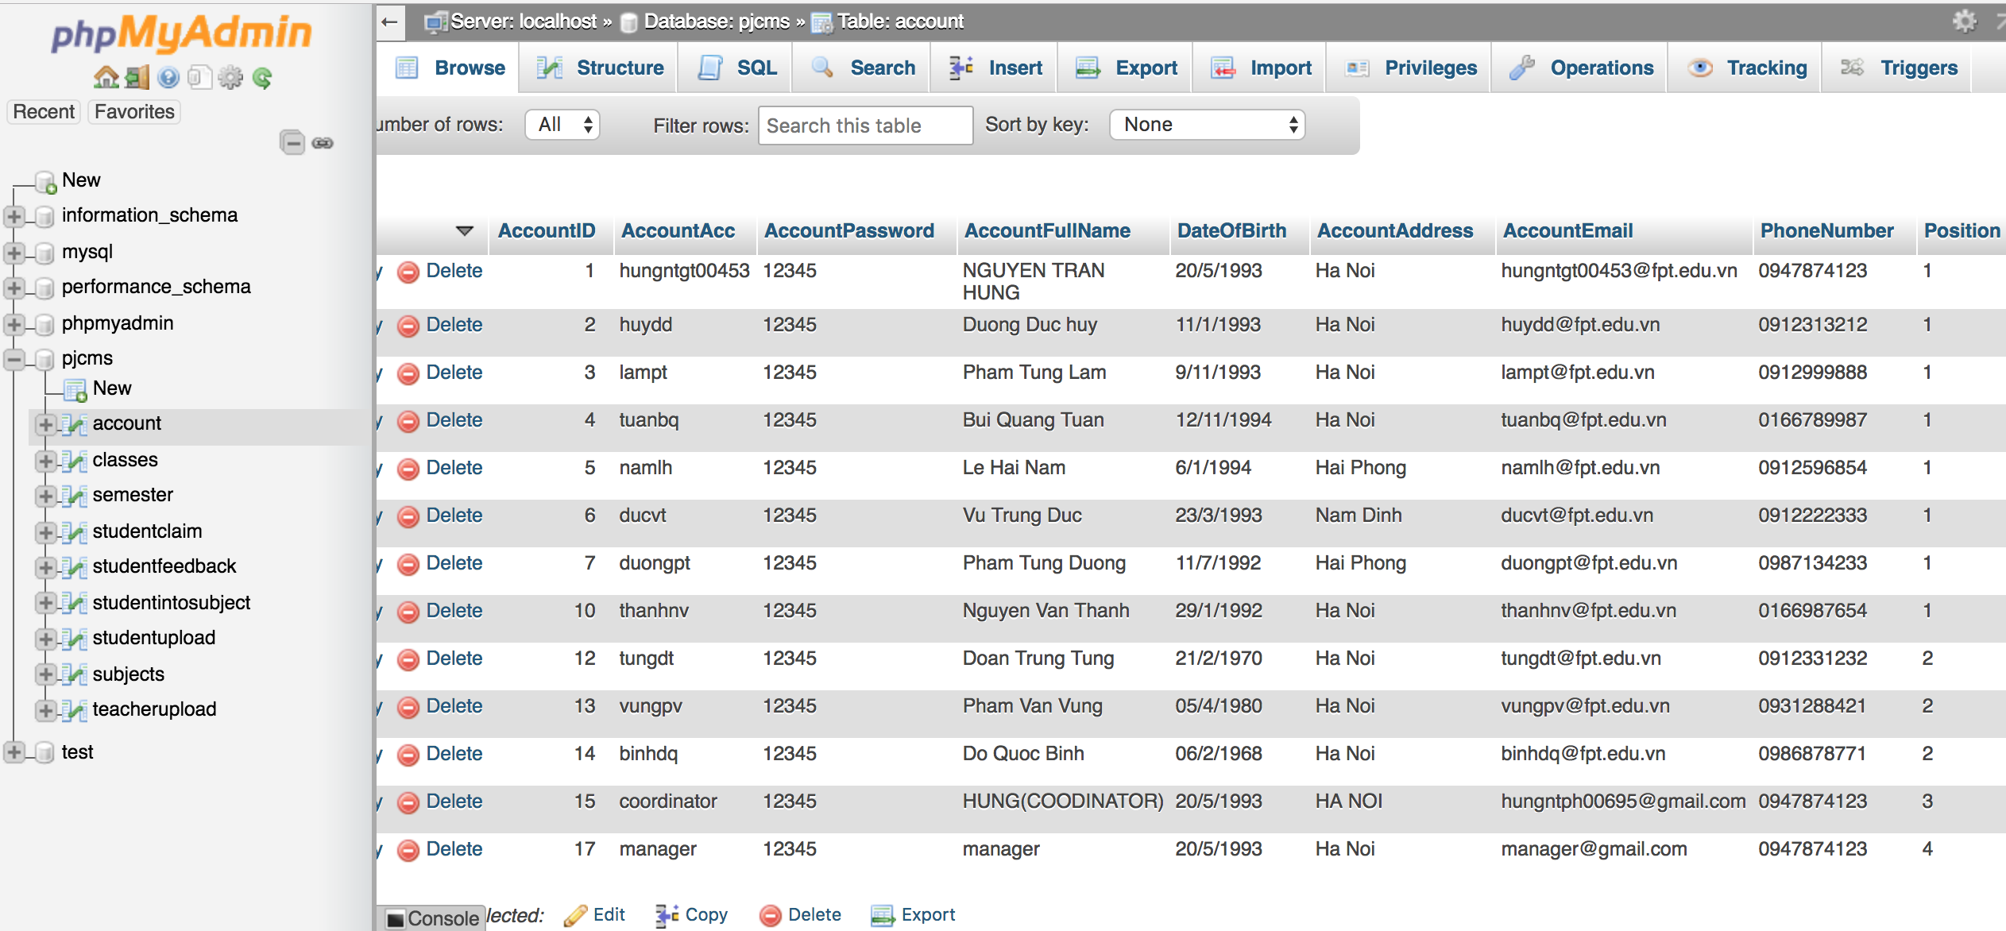
Role based system

Slide 10
Site design
REPONSIVE DESIGN
TESTING IN DIFFERENT SCREEN SOLUTION
USABILITY
ACCESSBILITY

Slide 11
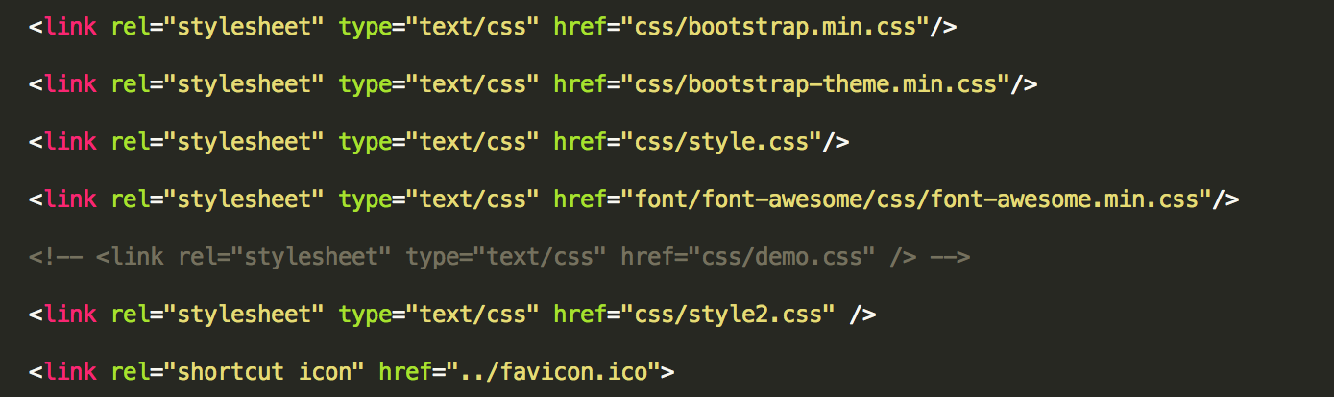
Site design
I use Bootstrap for design responsive
Site design

Slide 12
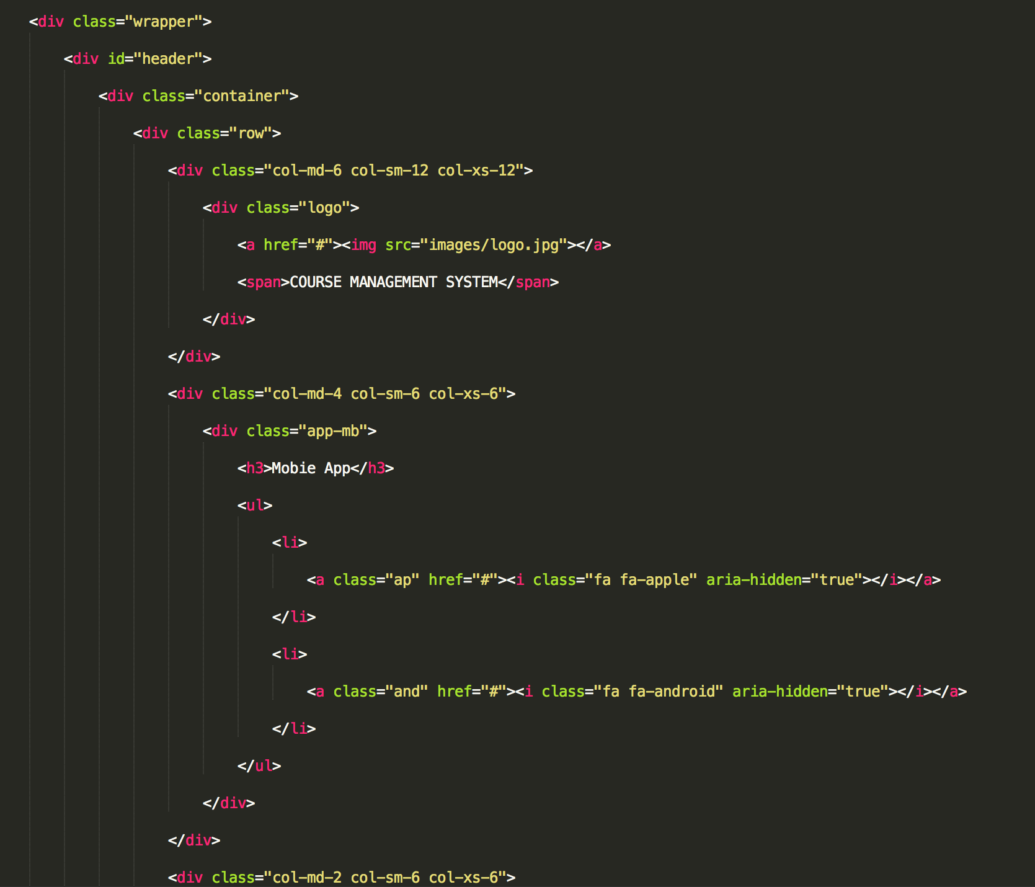
Site design
I use Bootstrap for design responsive
Site design

Slide 13

TESTING IN DIFFERENT SCREEN SOLUTION
Test on Chrome Browser

Slide 14
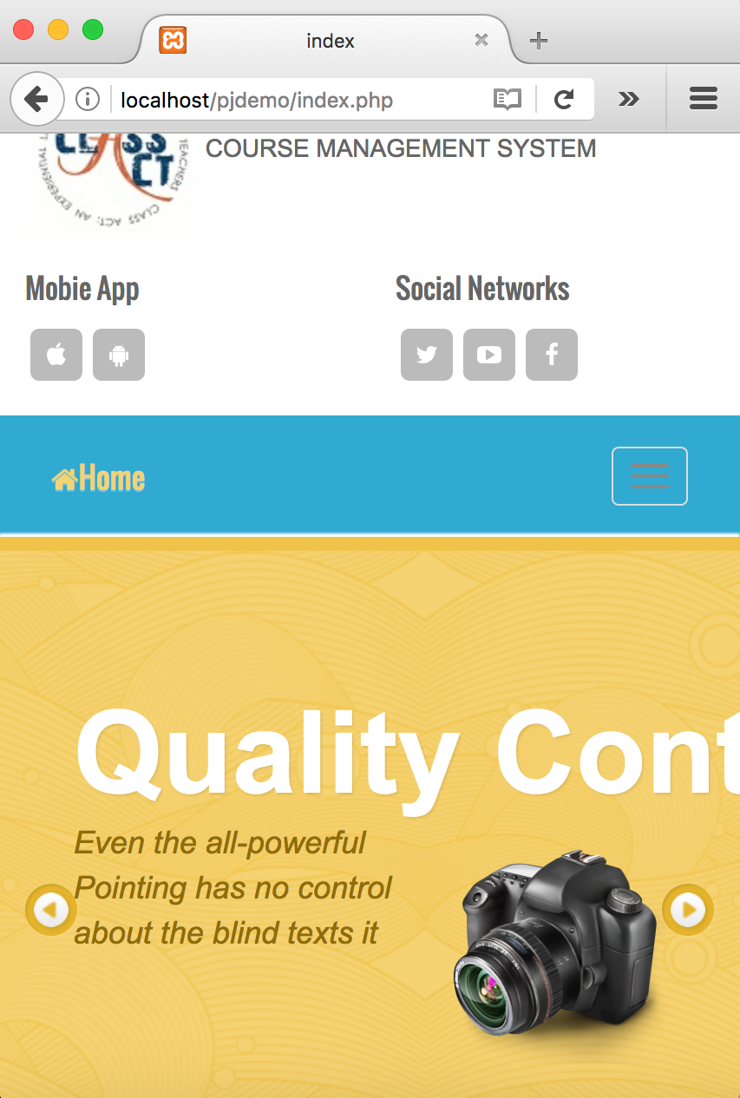
TESTING IN DIFFERENT SCREEN SOLUTION
Test on Firefox Browser

Slide 15
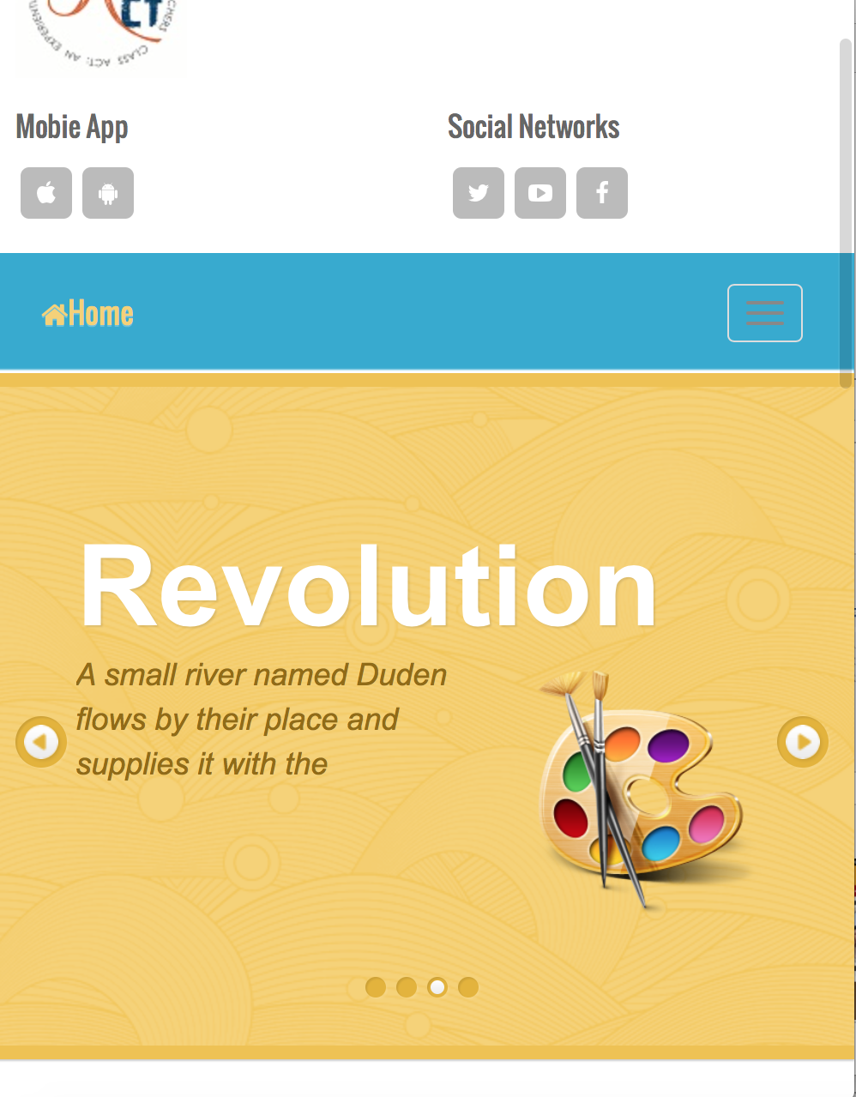
TESTING IN DIFFERENT SCREEN SOLUTION
Test on Safari Browser

Slide 16
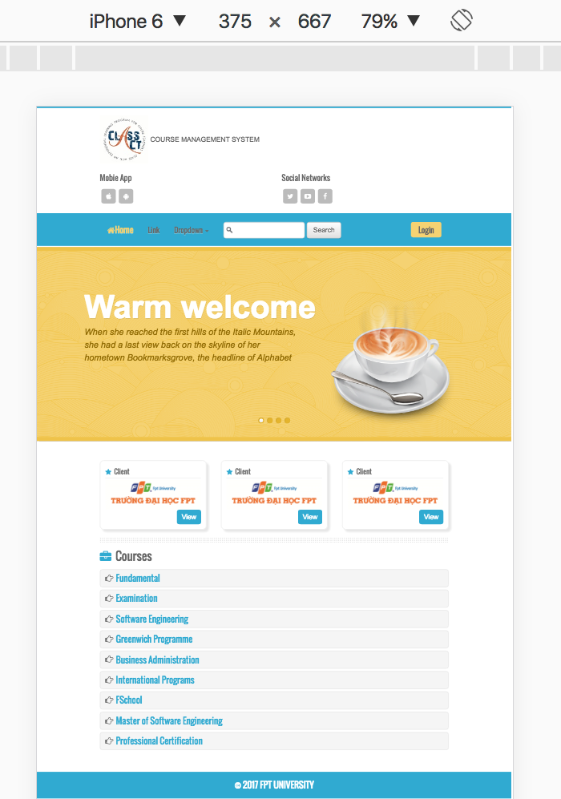
TESTING IN DIFFERENT SCREEN SOLUTION
Test on mobile iPhone 6

Slide 17
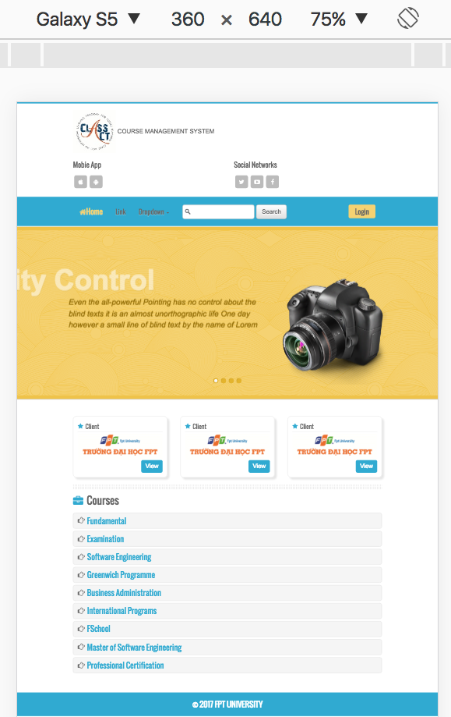
TESTING IN DIFFERENT SCREEN SOLUTION
Test on mobile Galaxy S5

Slide 18
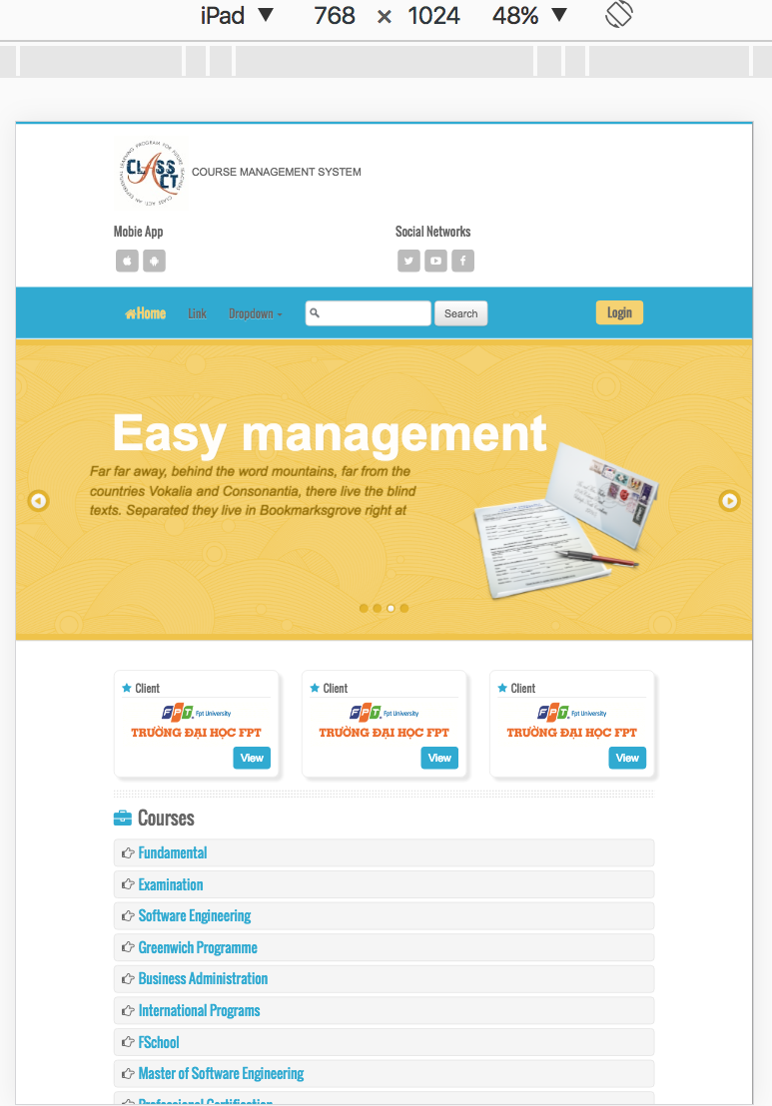
TESTING IN DIFFERENT SCREEN SOLUTION
Test on tablet iPad

Slide 19
Web usability
WEB USABILITY is the usability of website, check the website is easy to use, manipulation is friendly with the user

Slide 20

Web usability
MENTION ABOUT 5 SIDES OF WEB USABILITY
Learnability
User preference
Web Usability
Memorability
Speed
Efficiency

Slide 21
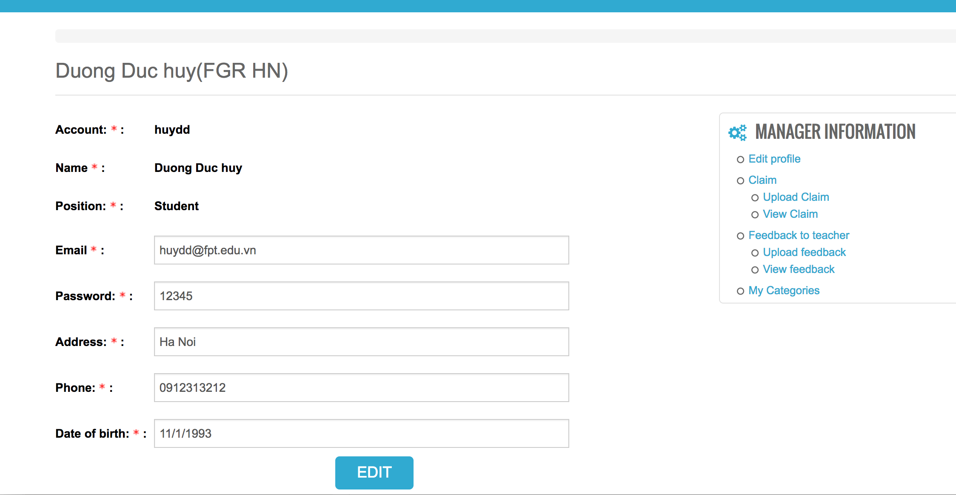
Web usability
Learnability – User has ability to learn to interact with the system
Clearly guide and logic, simple interact with the system

Slide 22
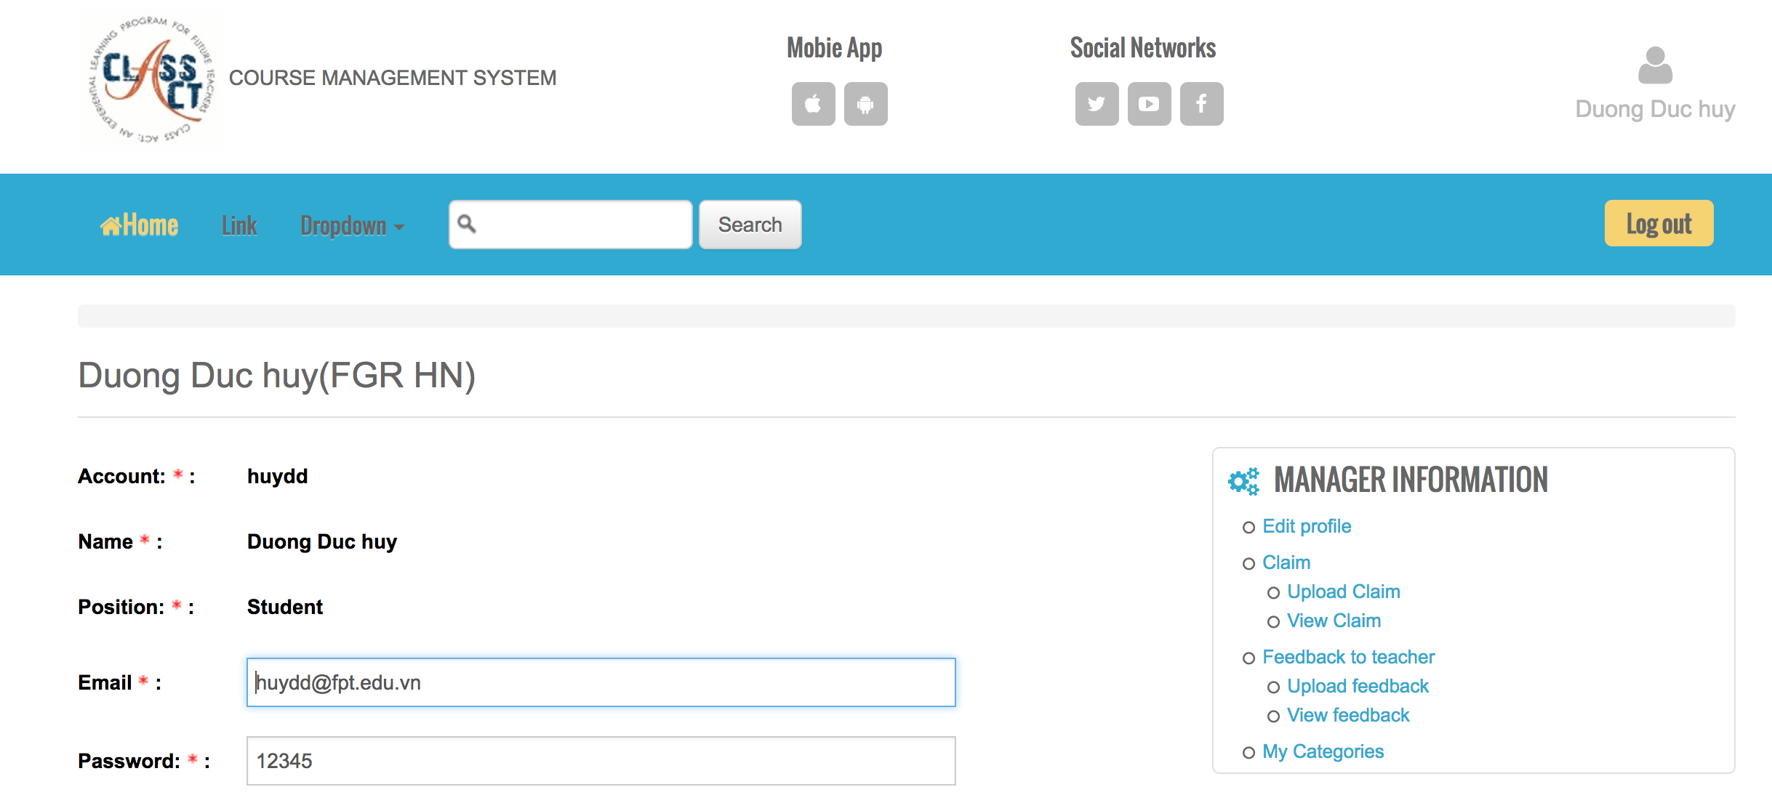
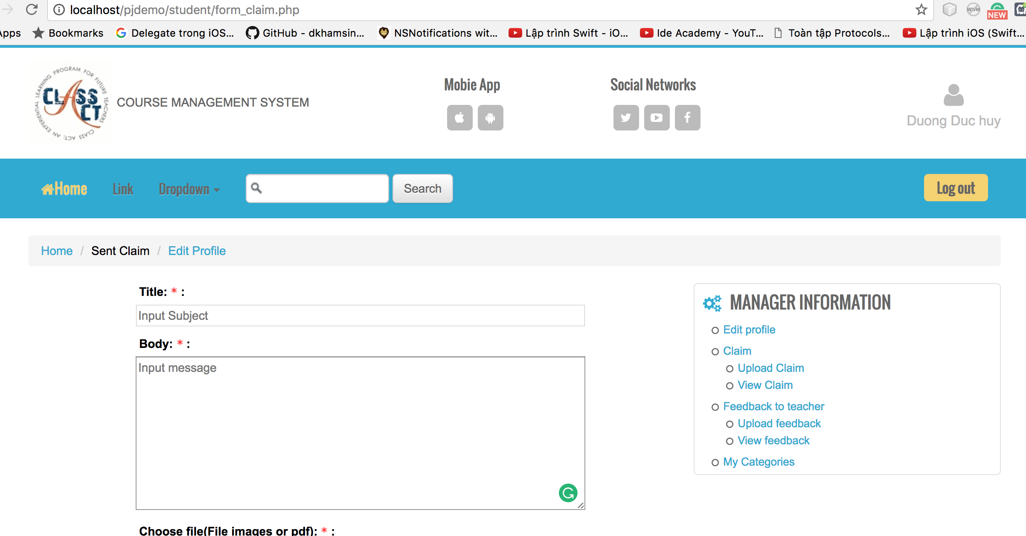
Web usability
Memorability
Maintain the consistent of system, user can use the memory to interact with system that used before, avoid user have to waste time to learn to interact to system again

Slide 23
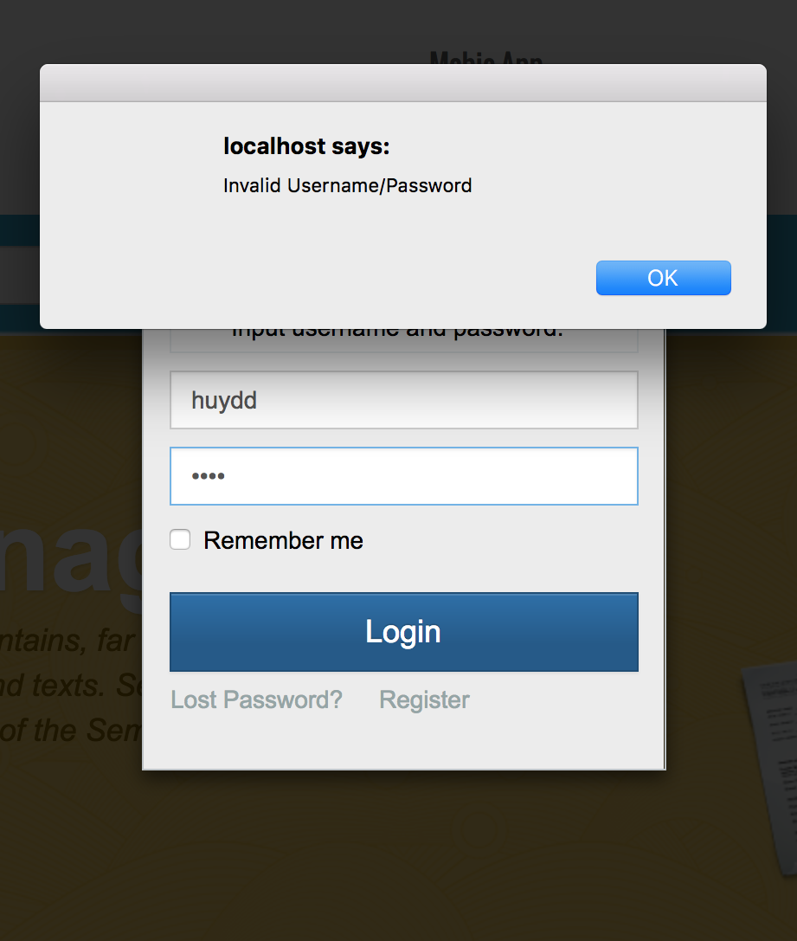
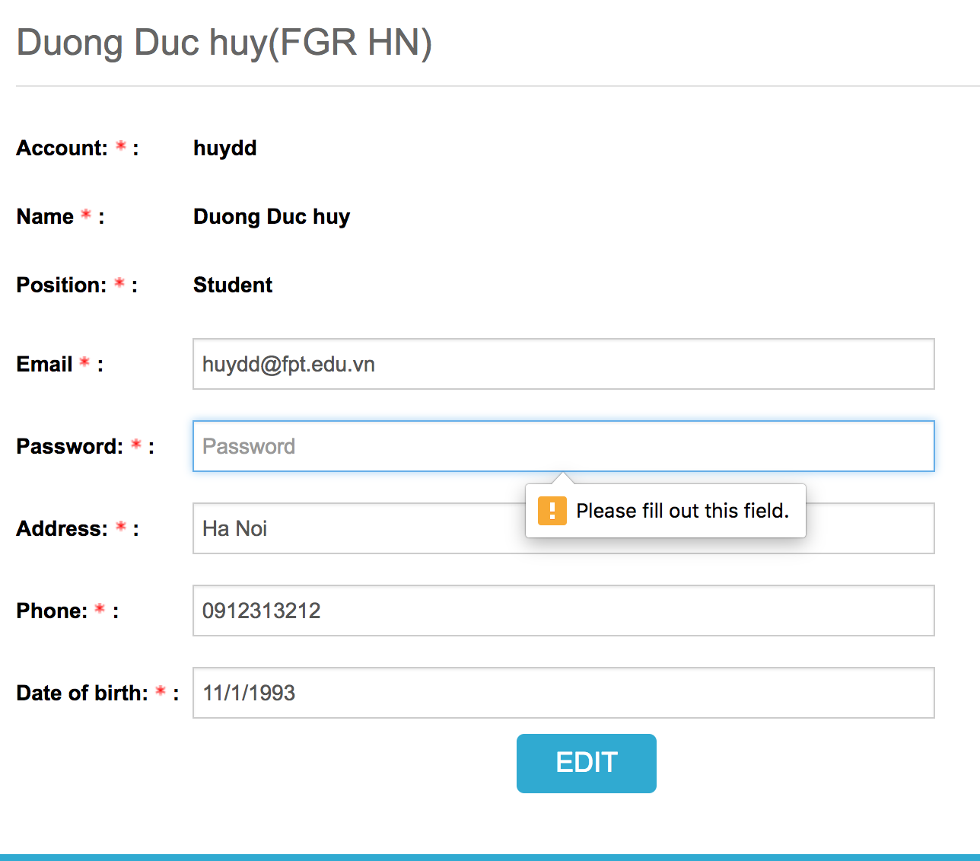
Web usability
Efficient
Prevent the user to make a bug, error when they do the wrong manipulation
Show alert to user.

Slide 24
Web usability
User preferences
Security the user information
Do the tasks that user wish to

Slide 25
Web accessibility
Web accessibility means that people with disabilities can use the Web
More specifically, Web accessibility means that people with disabilities can perceive, understand, navigate, and interact with the Web
My website still not solve the problem to develop accessibility

Slide 26
Functionality for each role in the website
The website has these main roles
Student
Teacher
Coordinator
Manager
. I will describe the functionality of each role base on User stories

Slide 27
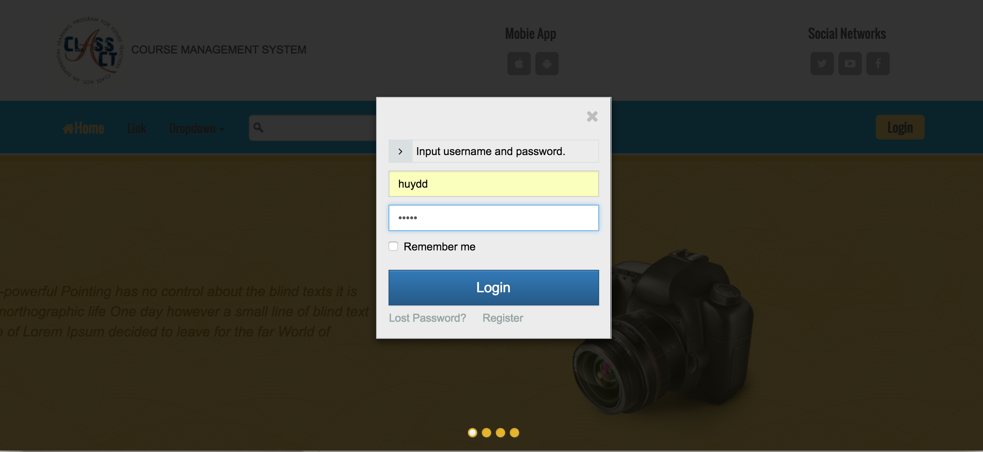
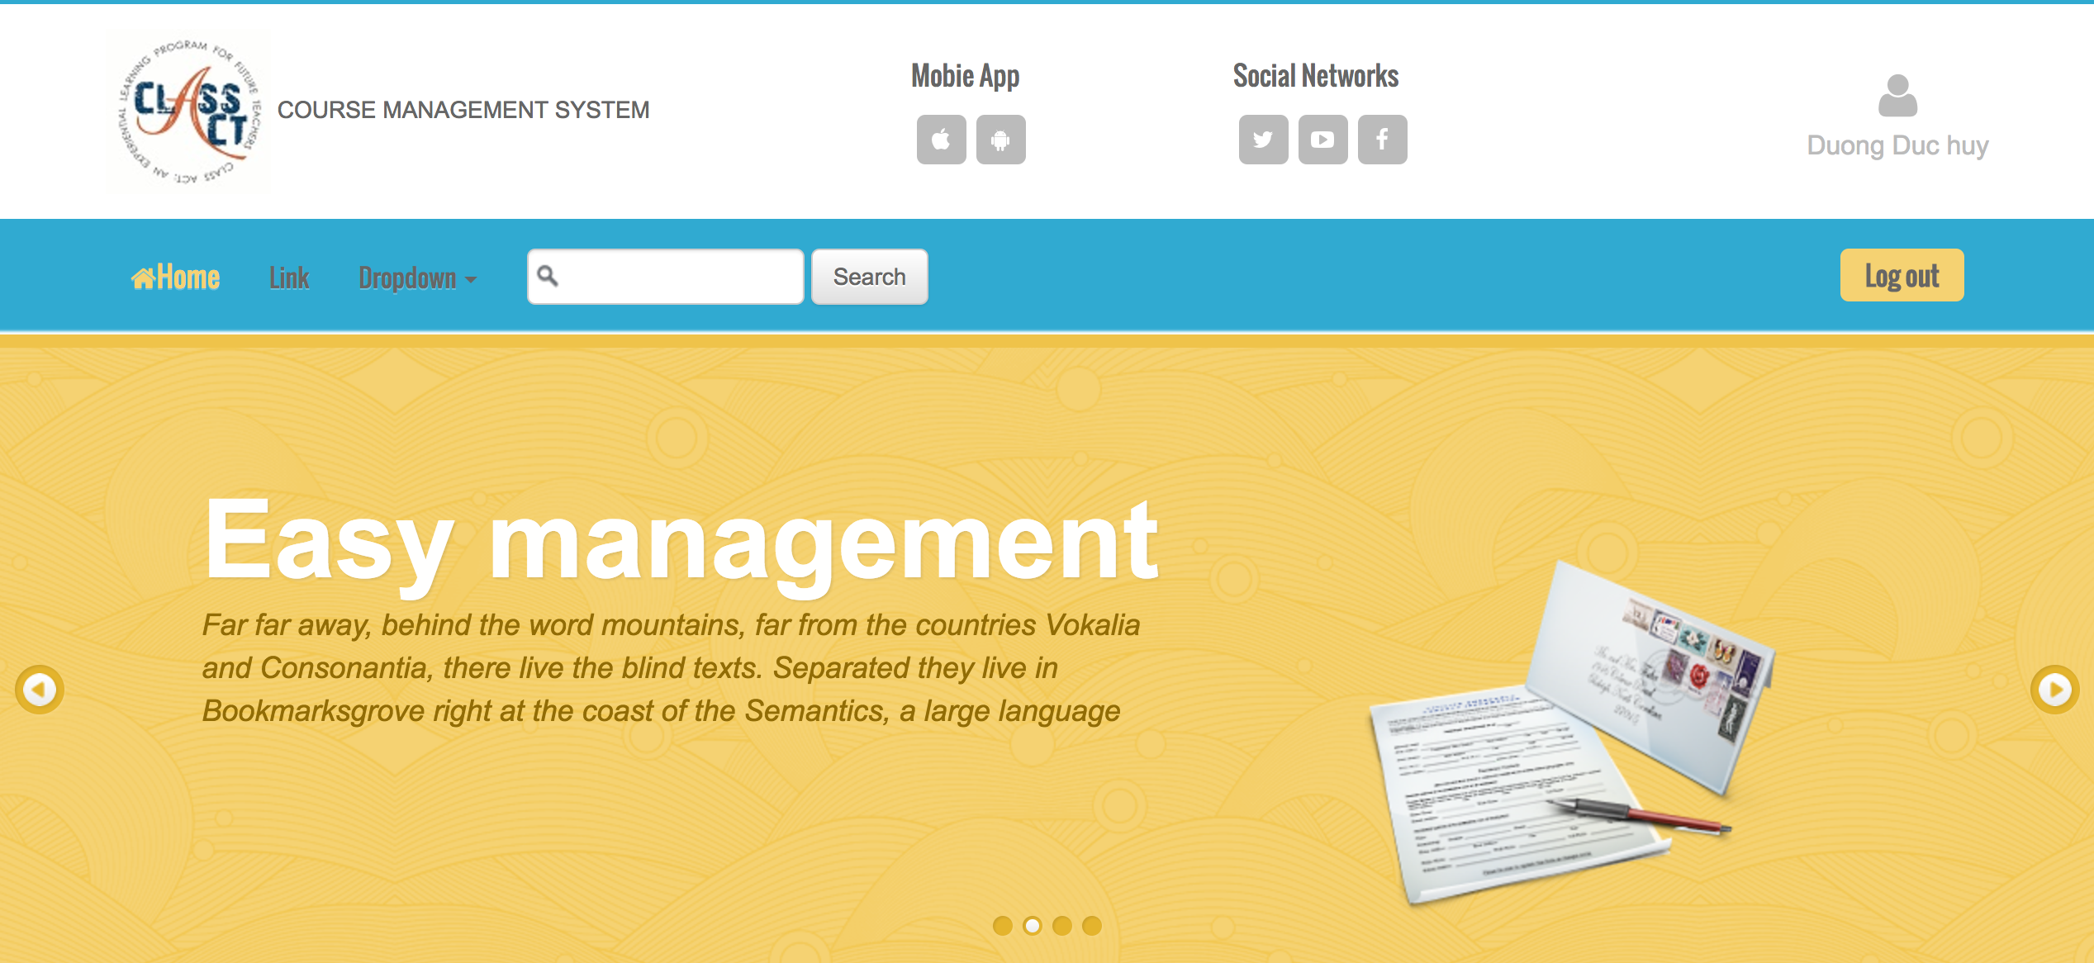
Functionality for each role in the website
As a Student.
Login/Logout to the System

Slide 28
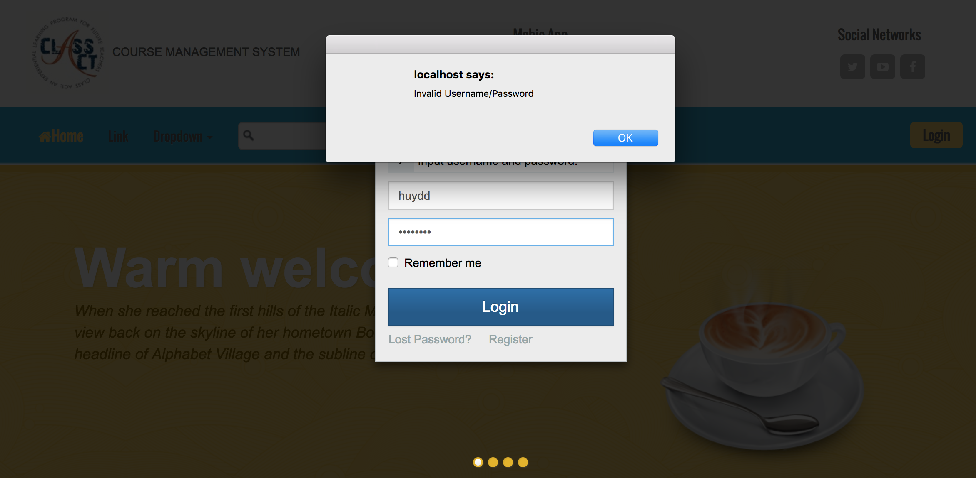
Functionality for each role in the website
As a Student
Login with validation data

Slide 29
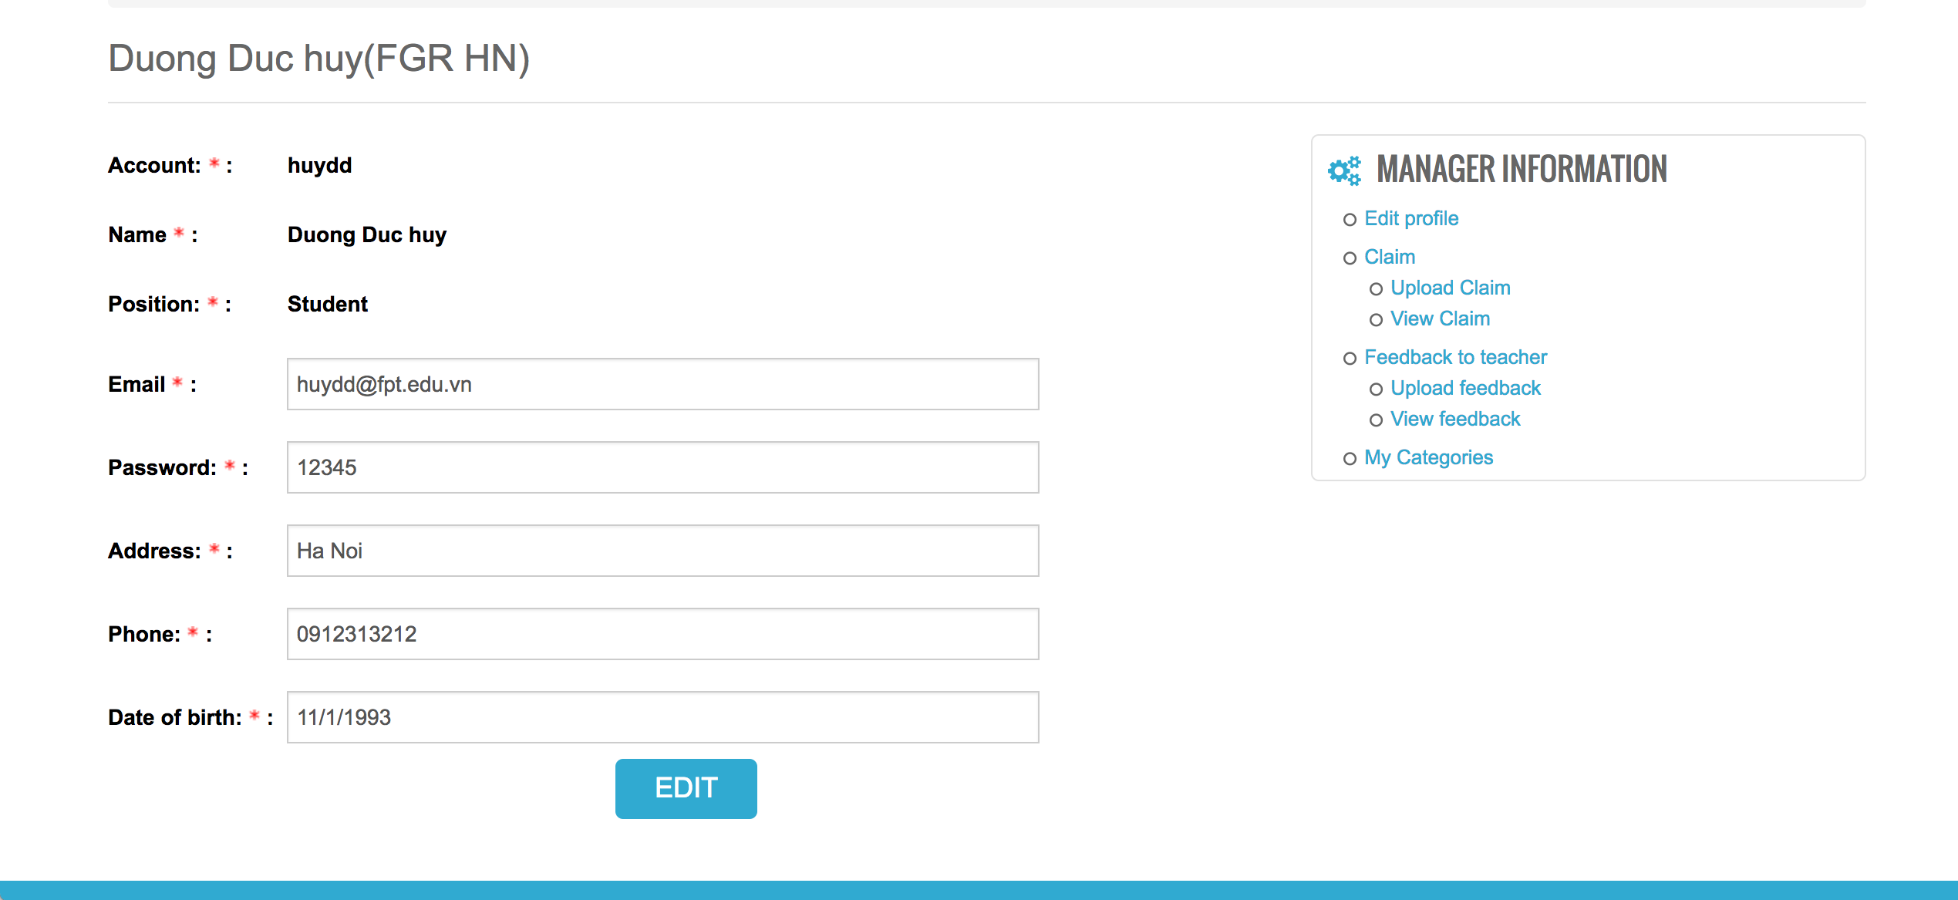
Functionality for each role in the website
As a Student
Edit the profile

Slide 30
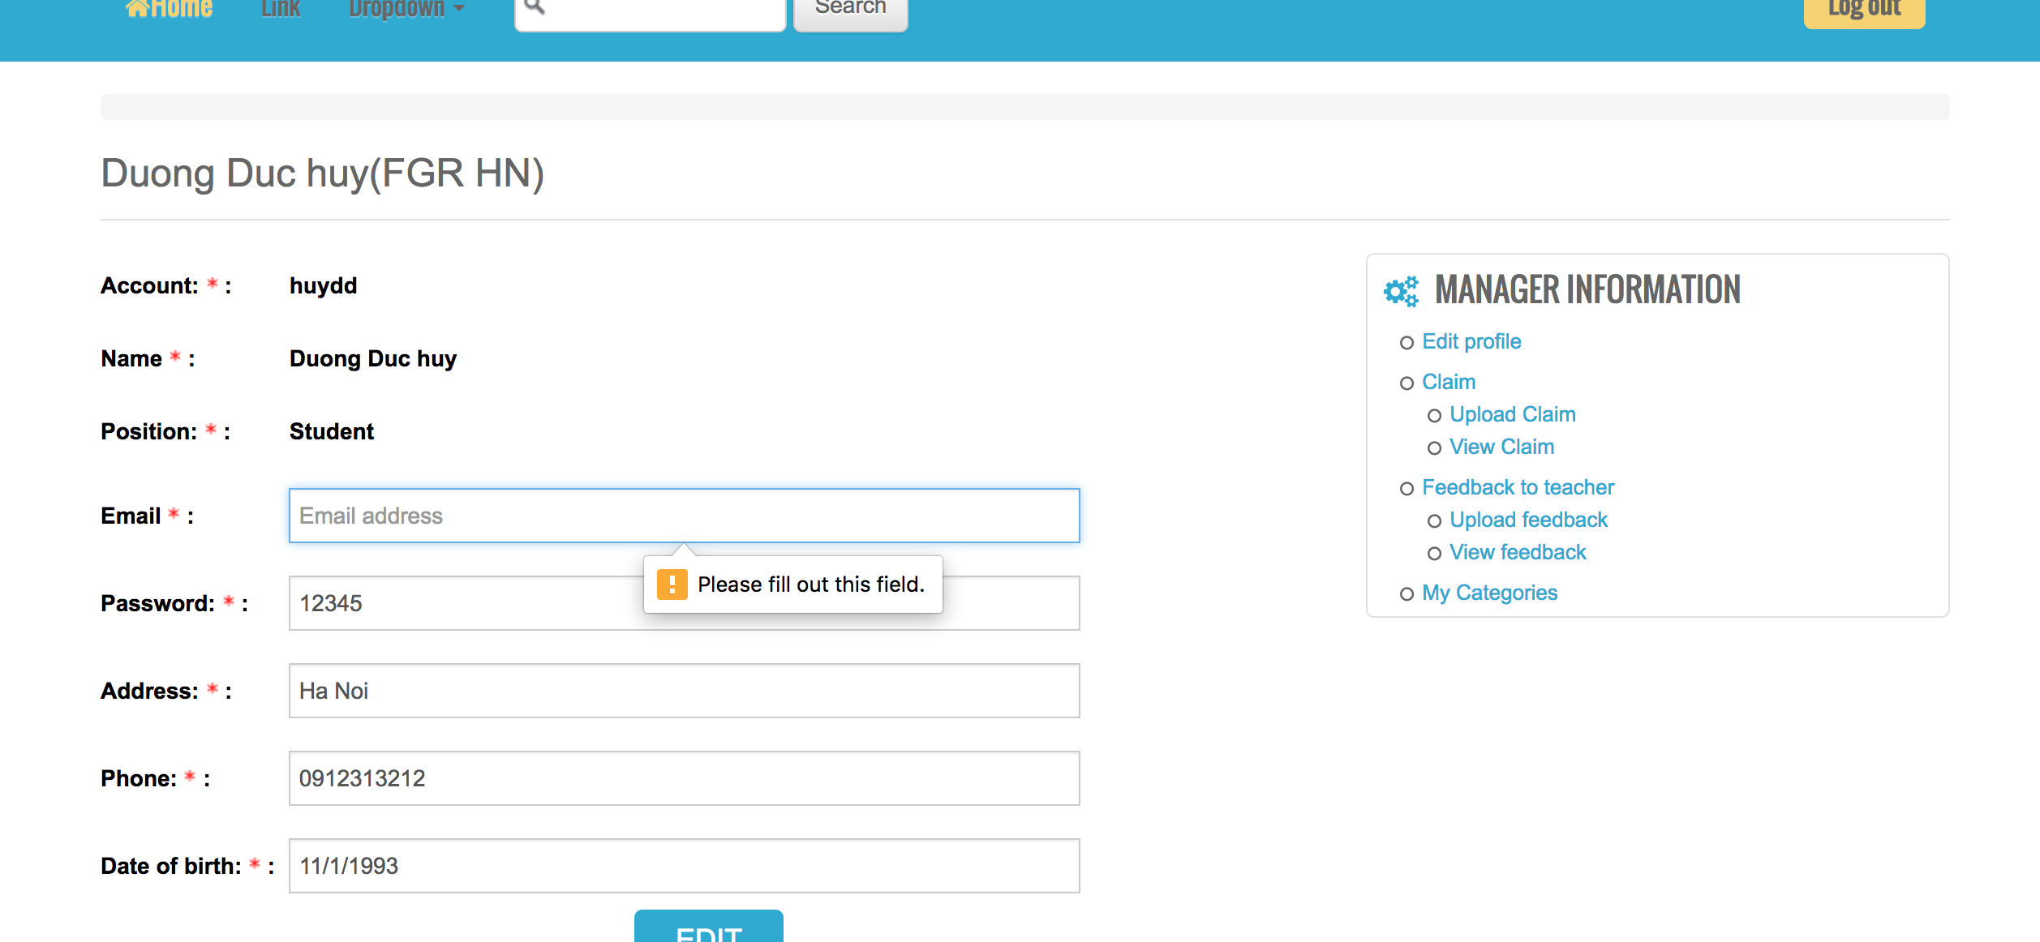
Functionality for each role in the website
As a Student
Edit the profile with validation data

Slide 31
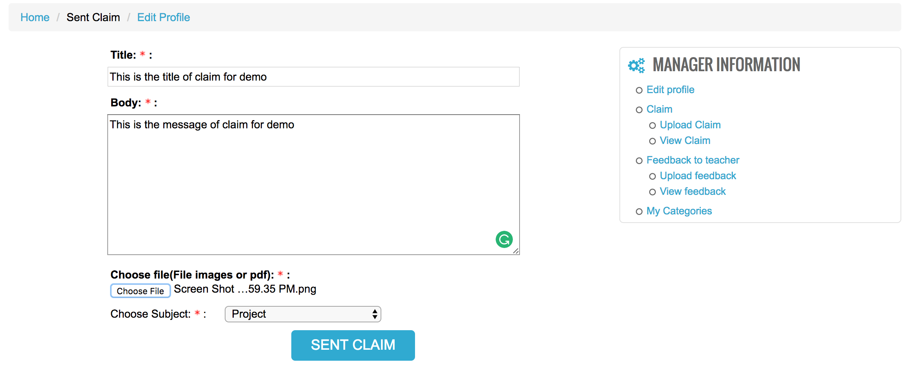
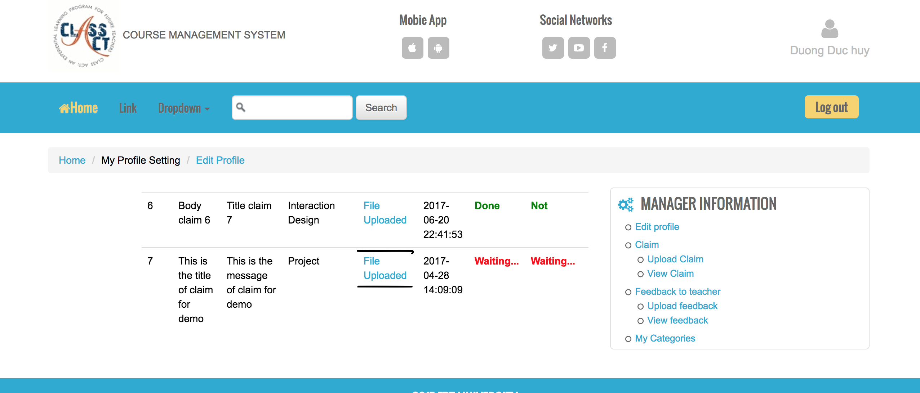
Functionality for each role in the website
As a student
Upload Claim with Evidence to Coordinator

Slide 32
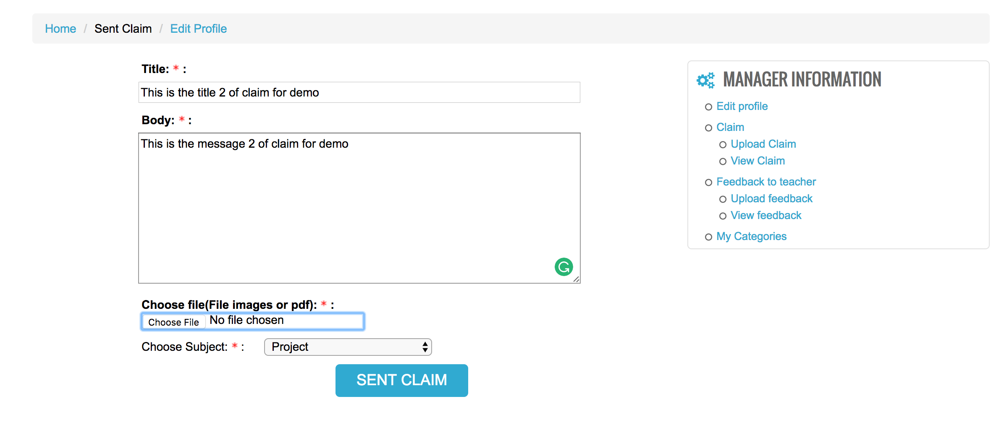
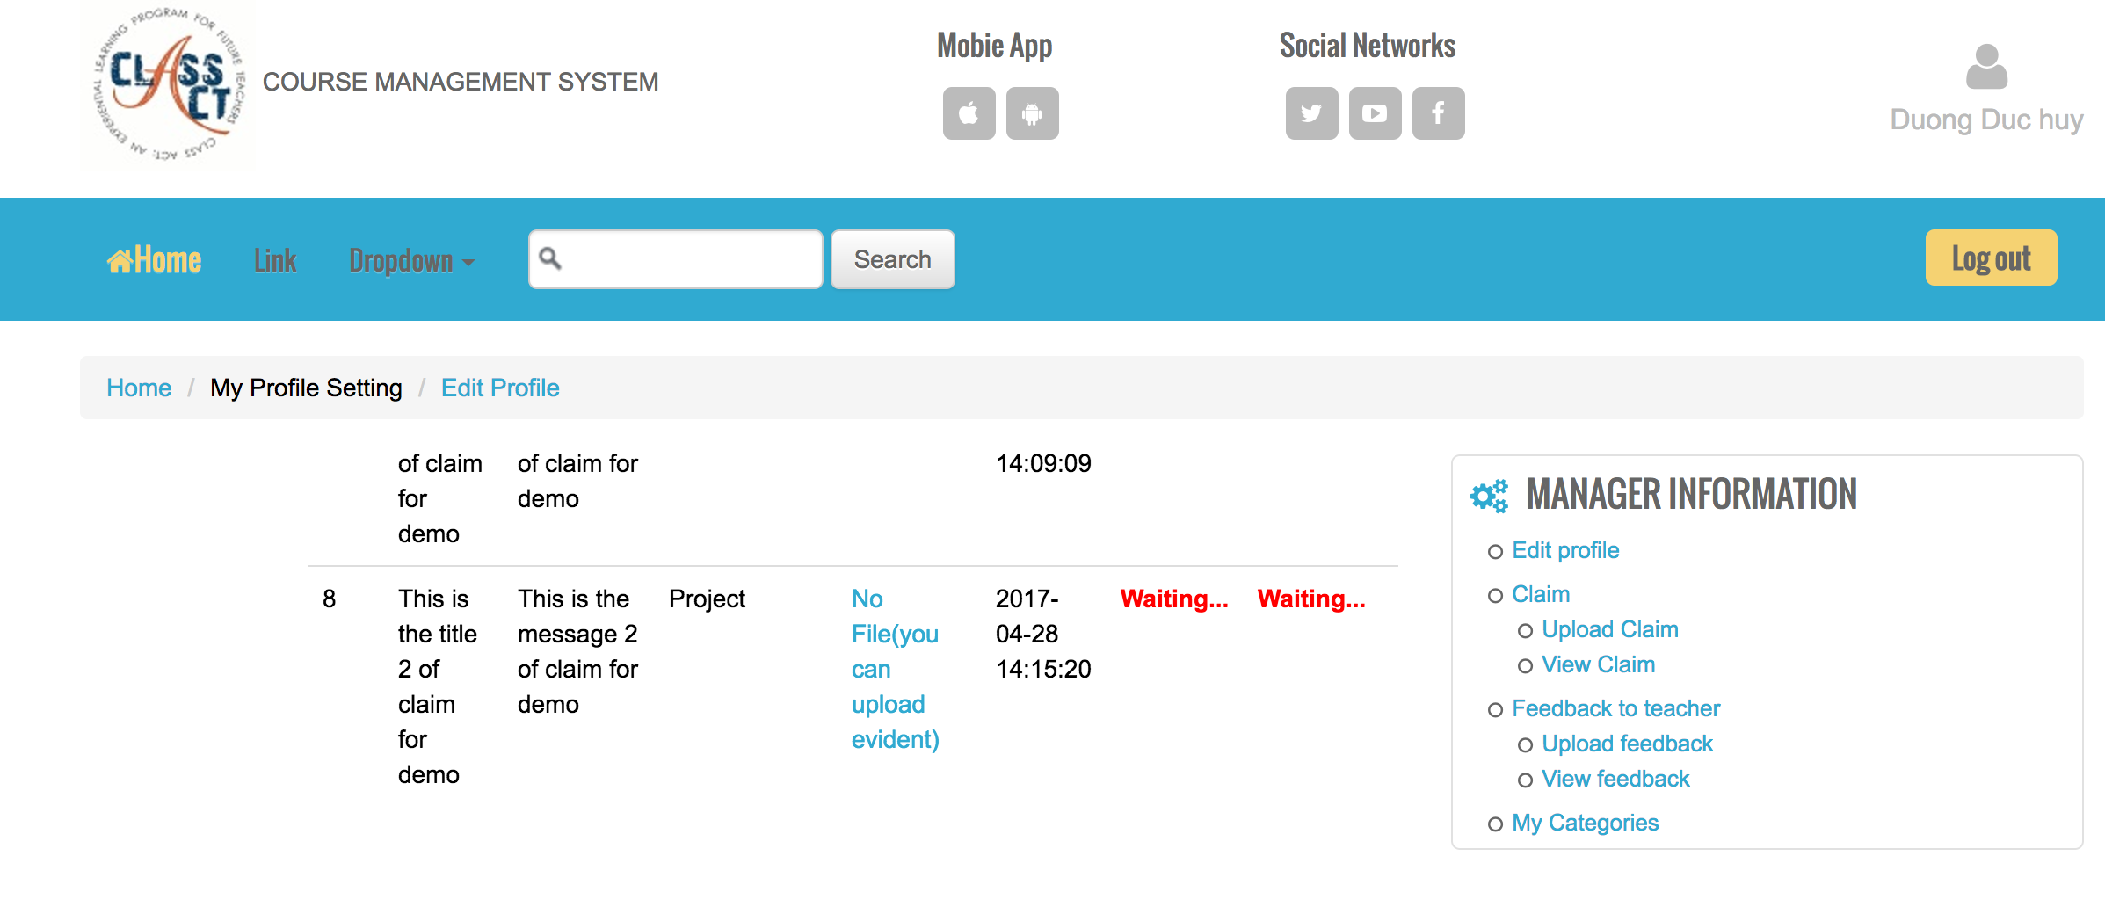
Functionality for each role in the website
As a student
Upload Claim without Evidence to Coordinator

Slide 33
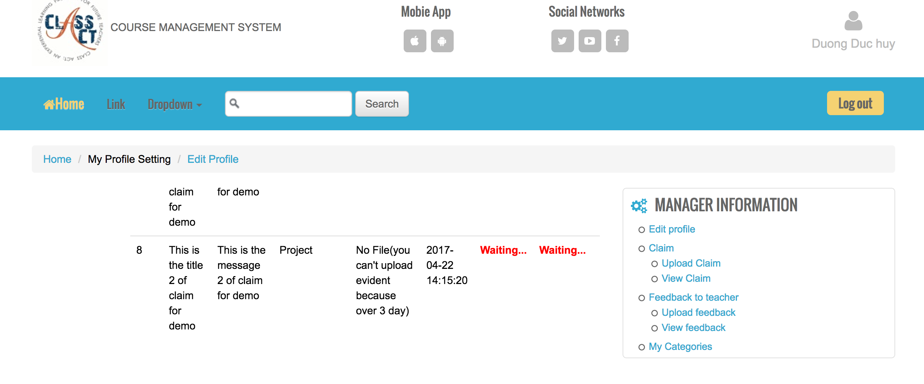
Functionality for each role in the website
As a student
I can upload Evidence later but no more than 3 day
U can not upload Evidence because the claim is sent over 3 days

Slide 34
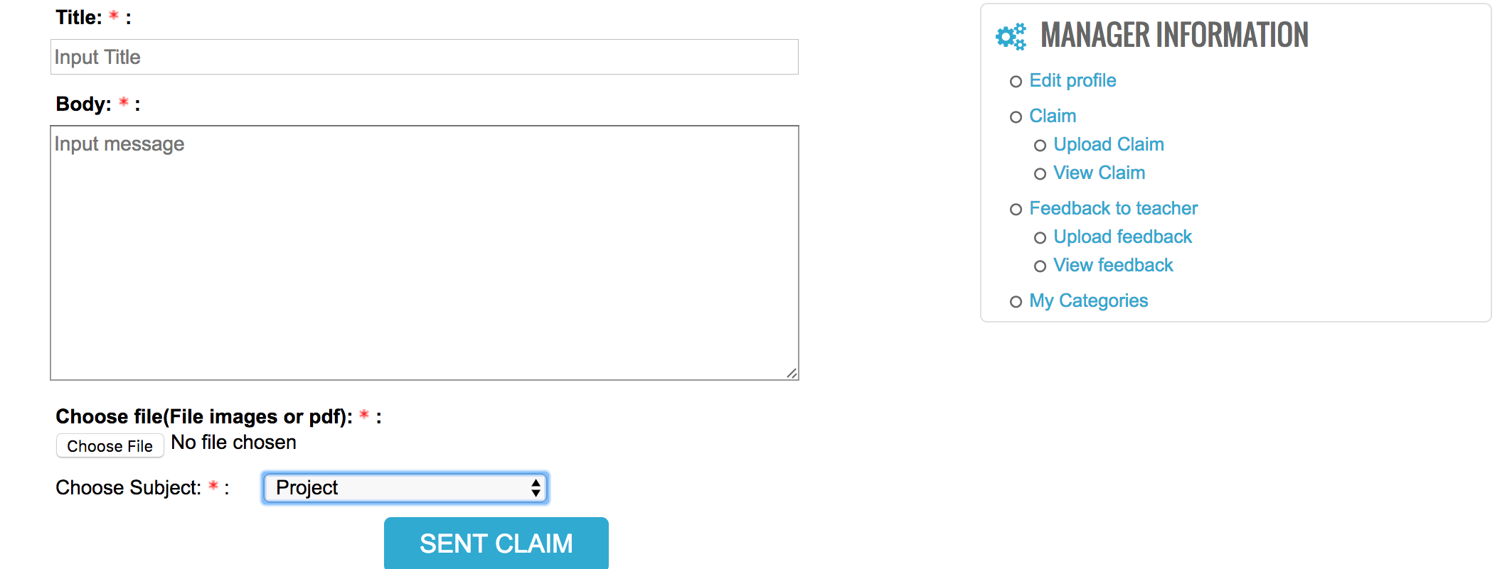
Functionality for each role in the website
As a Student
Can not upload Claim to the subject is overdue date

Slide 35
Functionality for each role in the website
As a student
I can view the detail of claim , the status meaning the coordinator is answer or not, the accepted meaning the coordinator accept or not.
I can receive the answer letter through the email

Slide 36
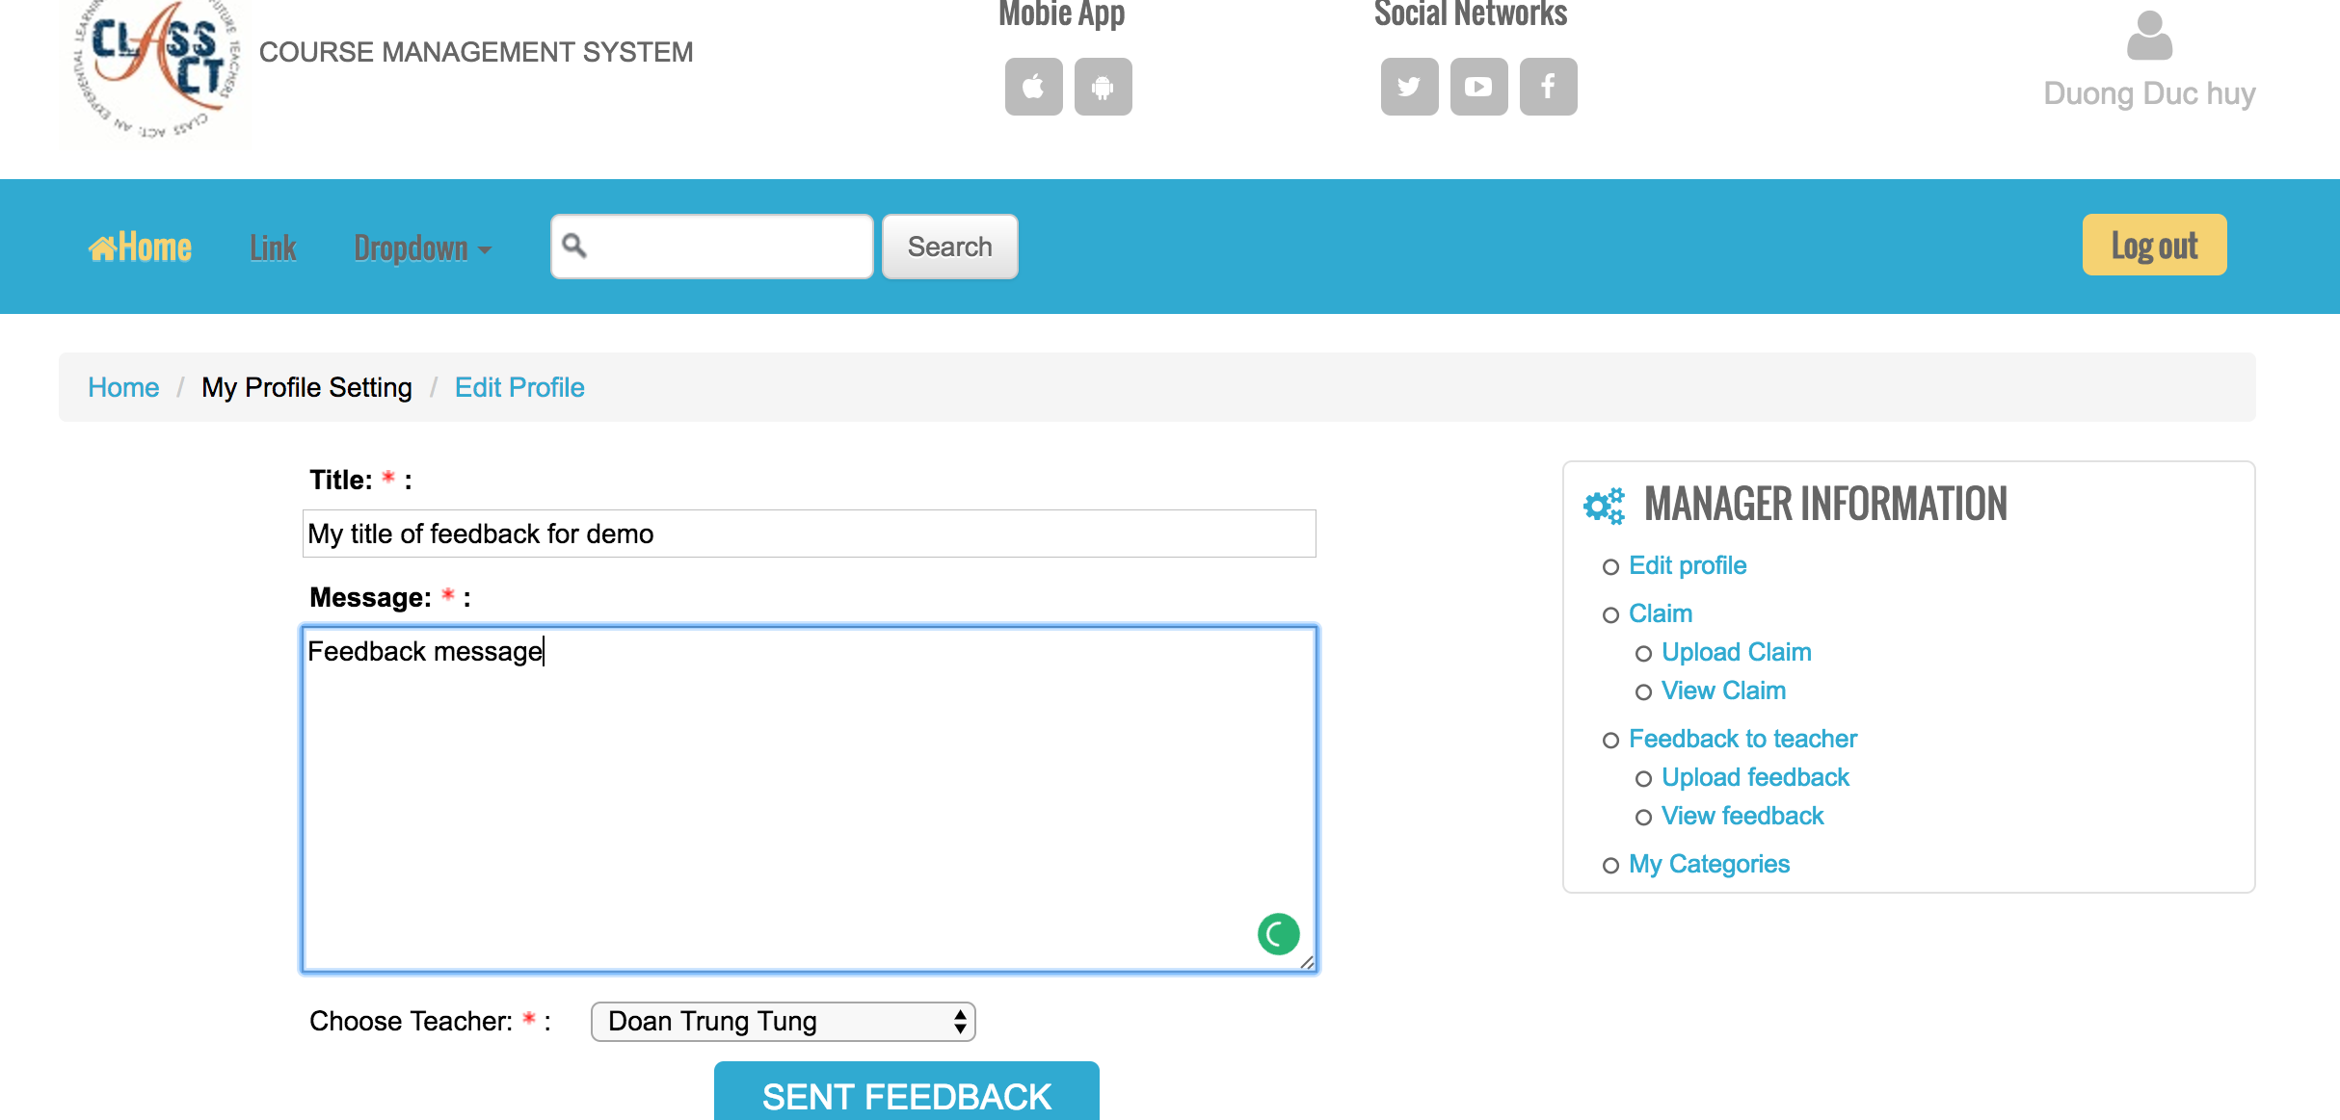
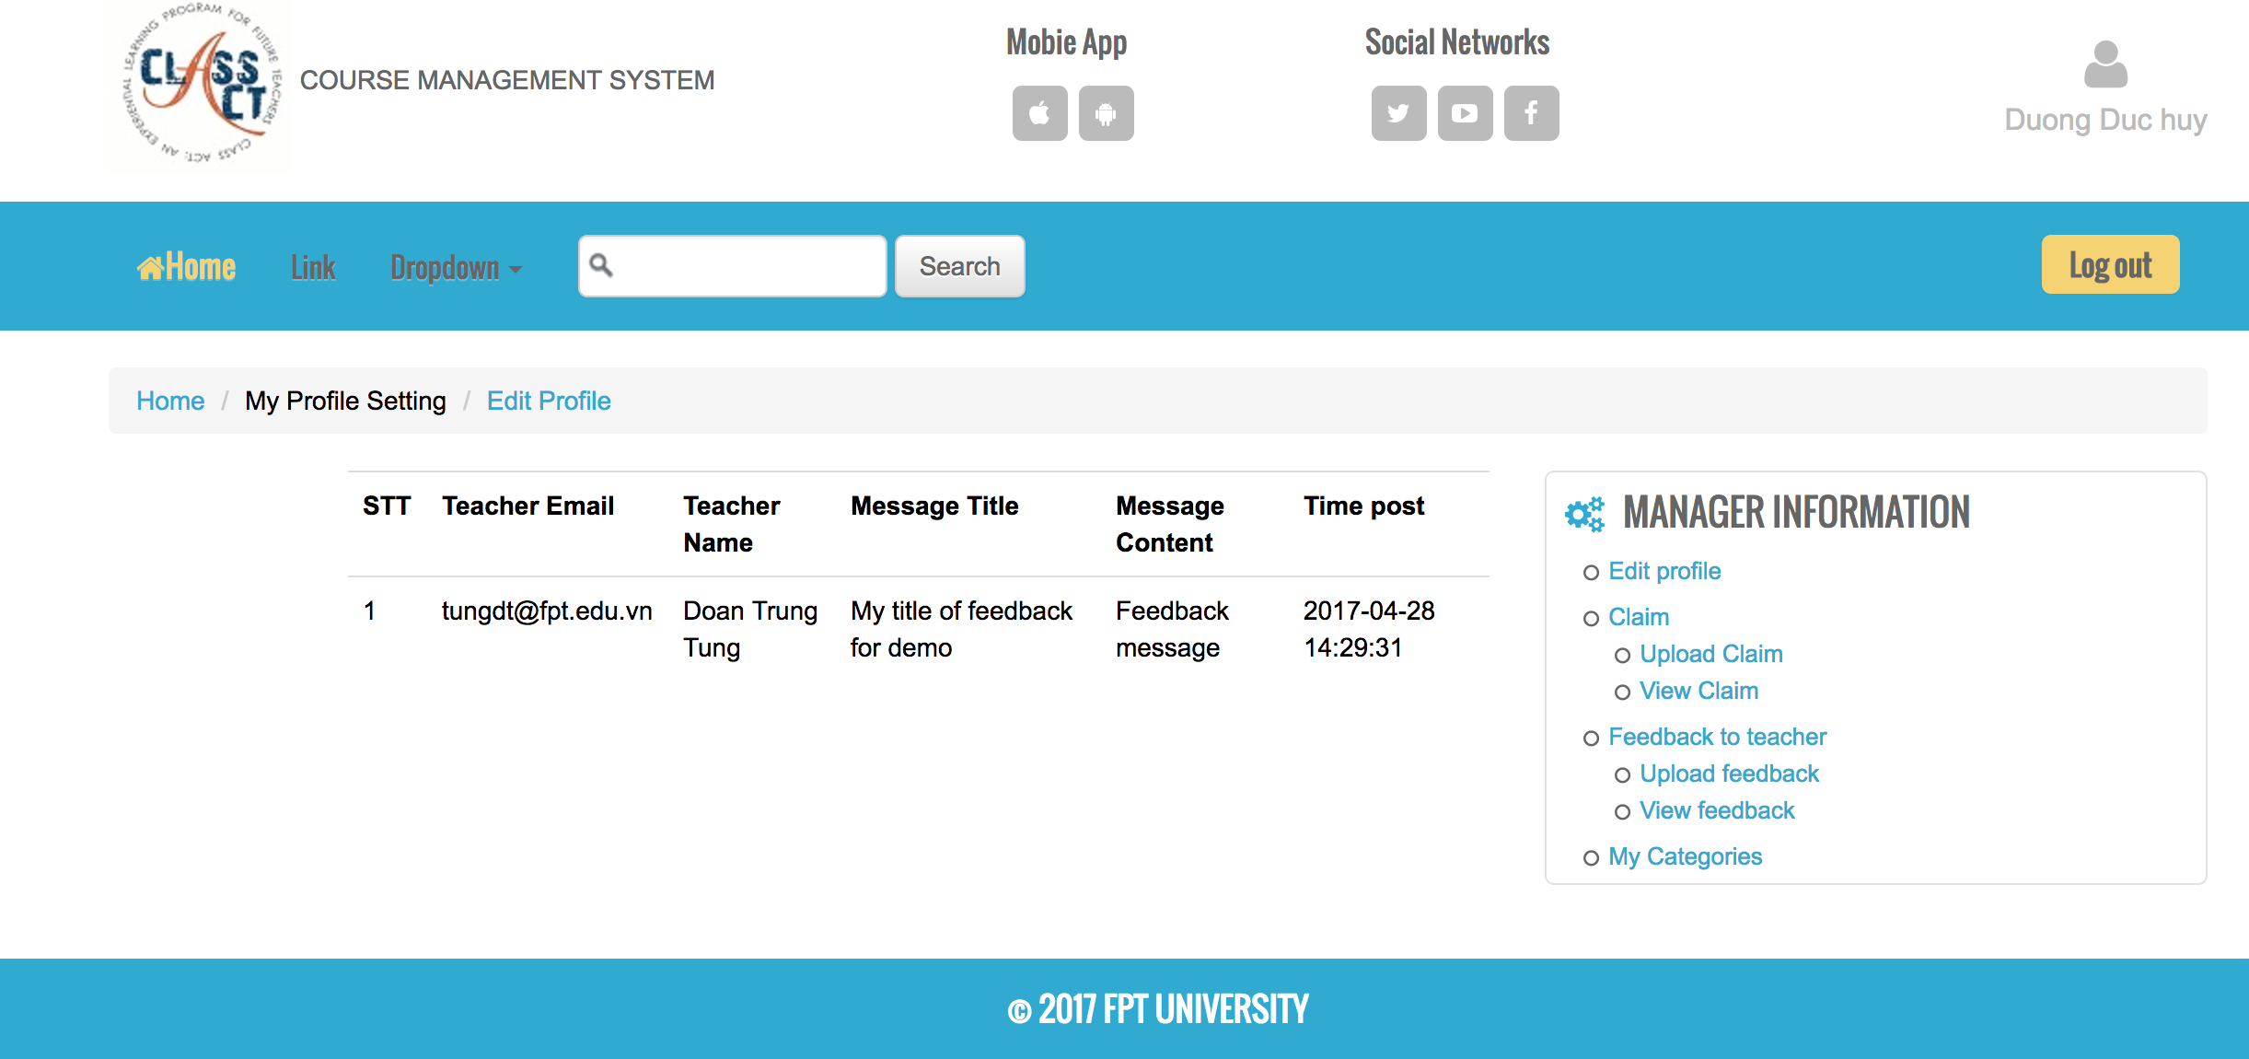
Functionality for each role in the website
As a Student
I can upload the feedback to the teacher and view my feedback that I have uploaded before

Slide 37
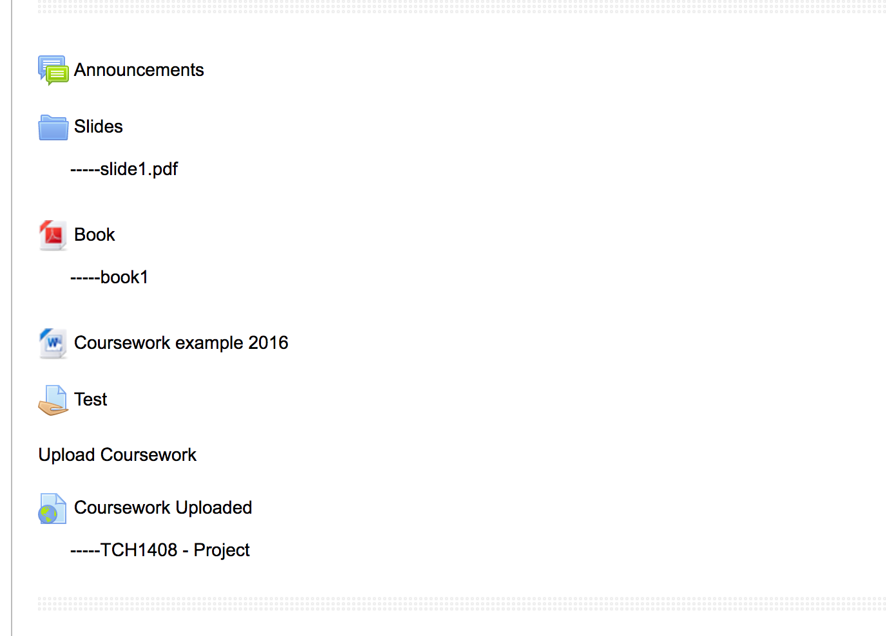
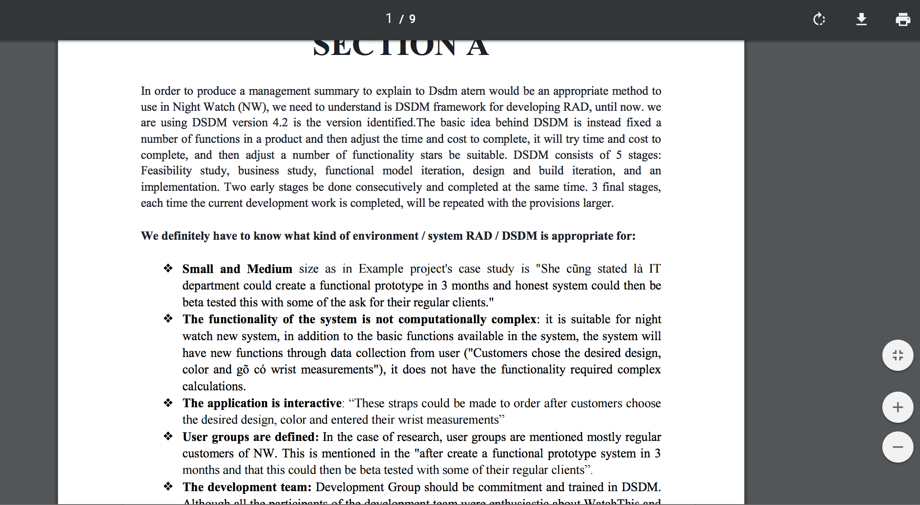
Functionality for each role in the website
As a student
I can view and download all of the document

Slide 38
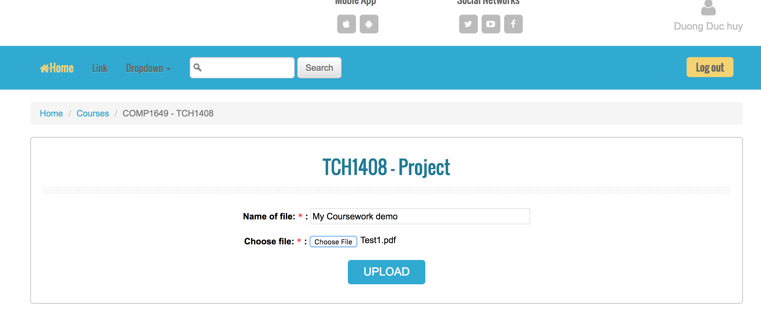
Functionality for each role in the website
As a student
I can upload the coursework

Slide 39
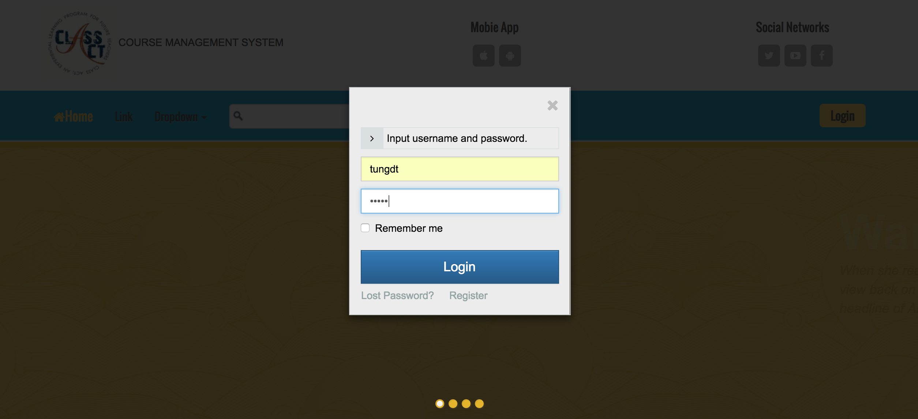
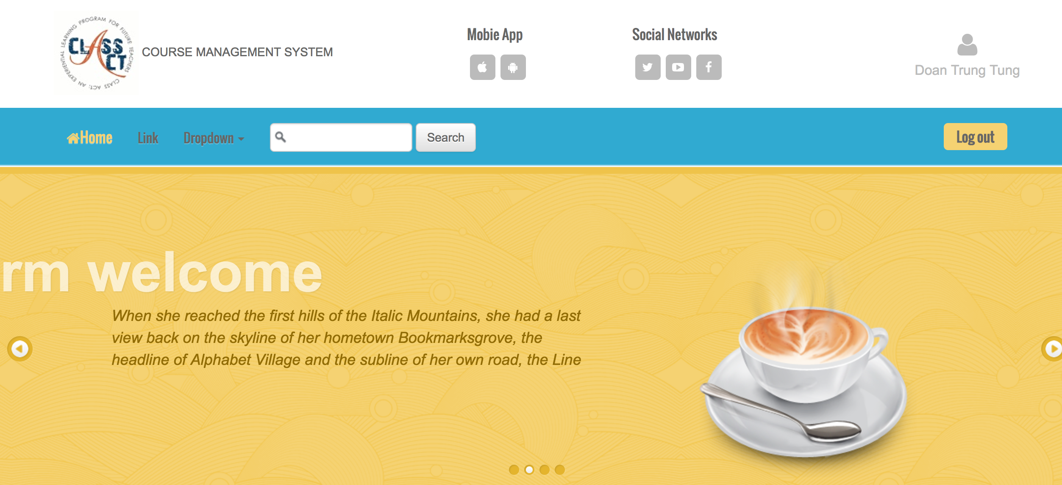
Functionality for each role in the website
As A Teacher
I can login/logout to system

Slide 40
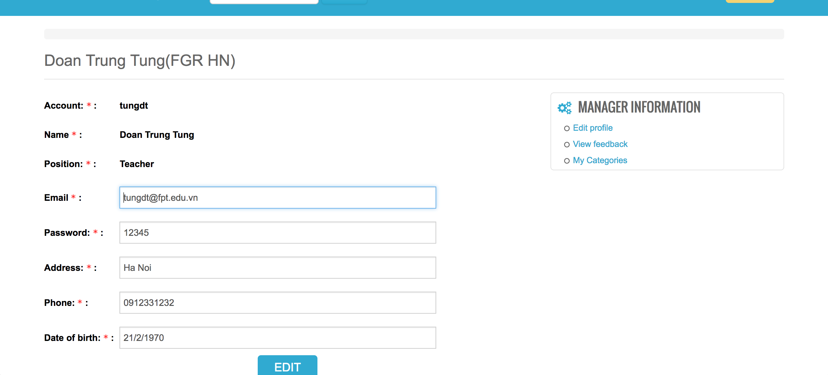
Functionality for each role in the website
As a Teacher
I can edit the profile

Slide 41
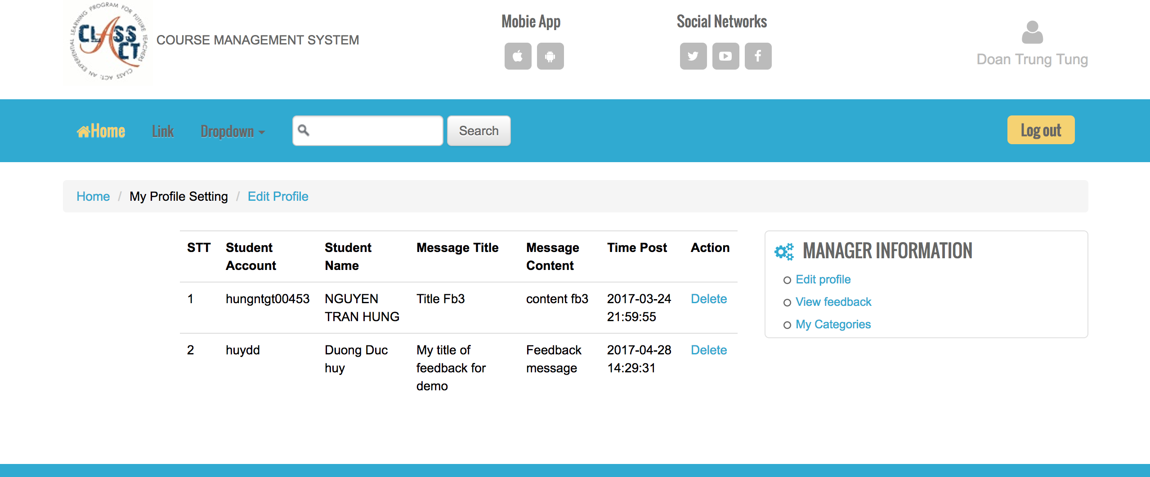
Functionality for each role in the website
As a Teacher
I can view all or delete the feedback that students sent to

Slide 42
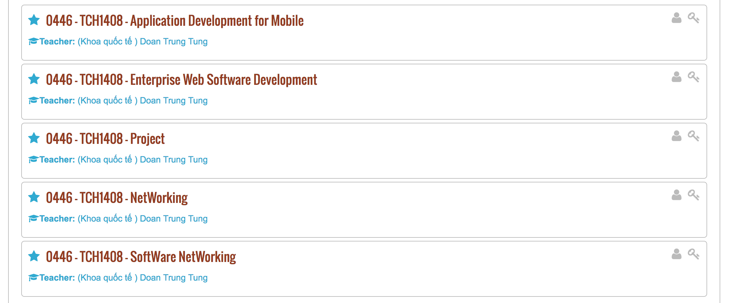
Functionality for each role in the website
As a teacher
I can view all the subjects that I am teaching

Slide 43
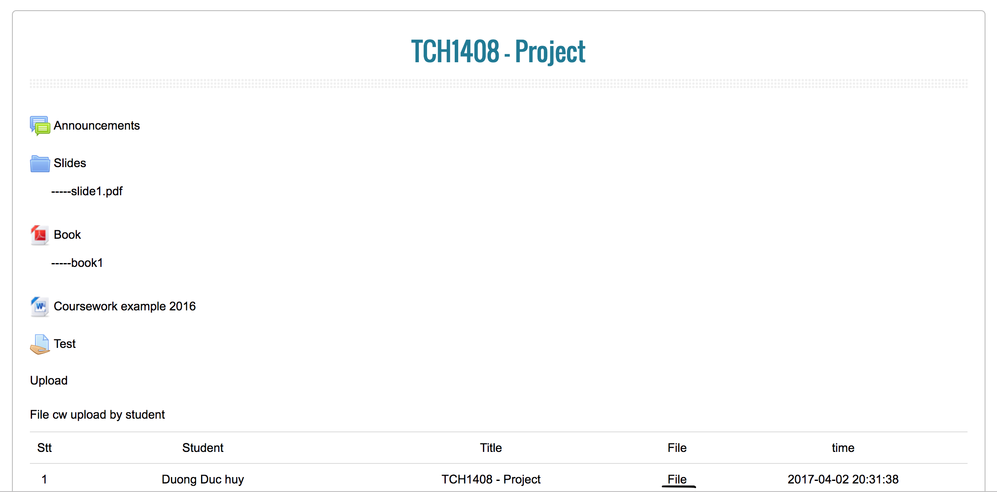
Functionality for each role in the website
As a Teacher
I can view all the document and the coursework that student uploaded by download it

Slide 44
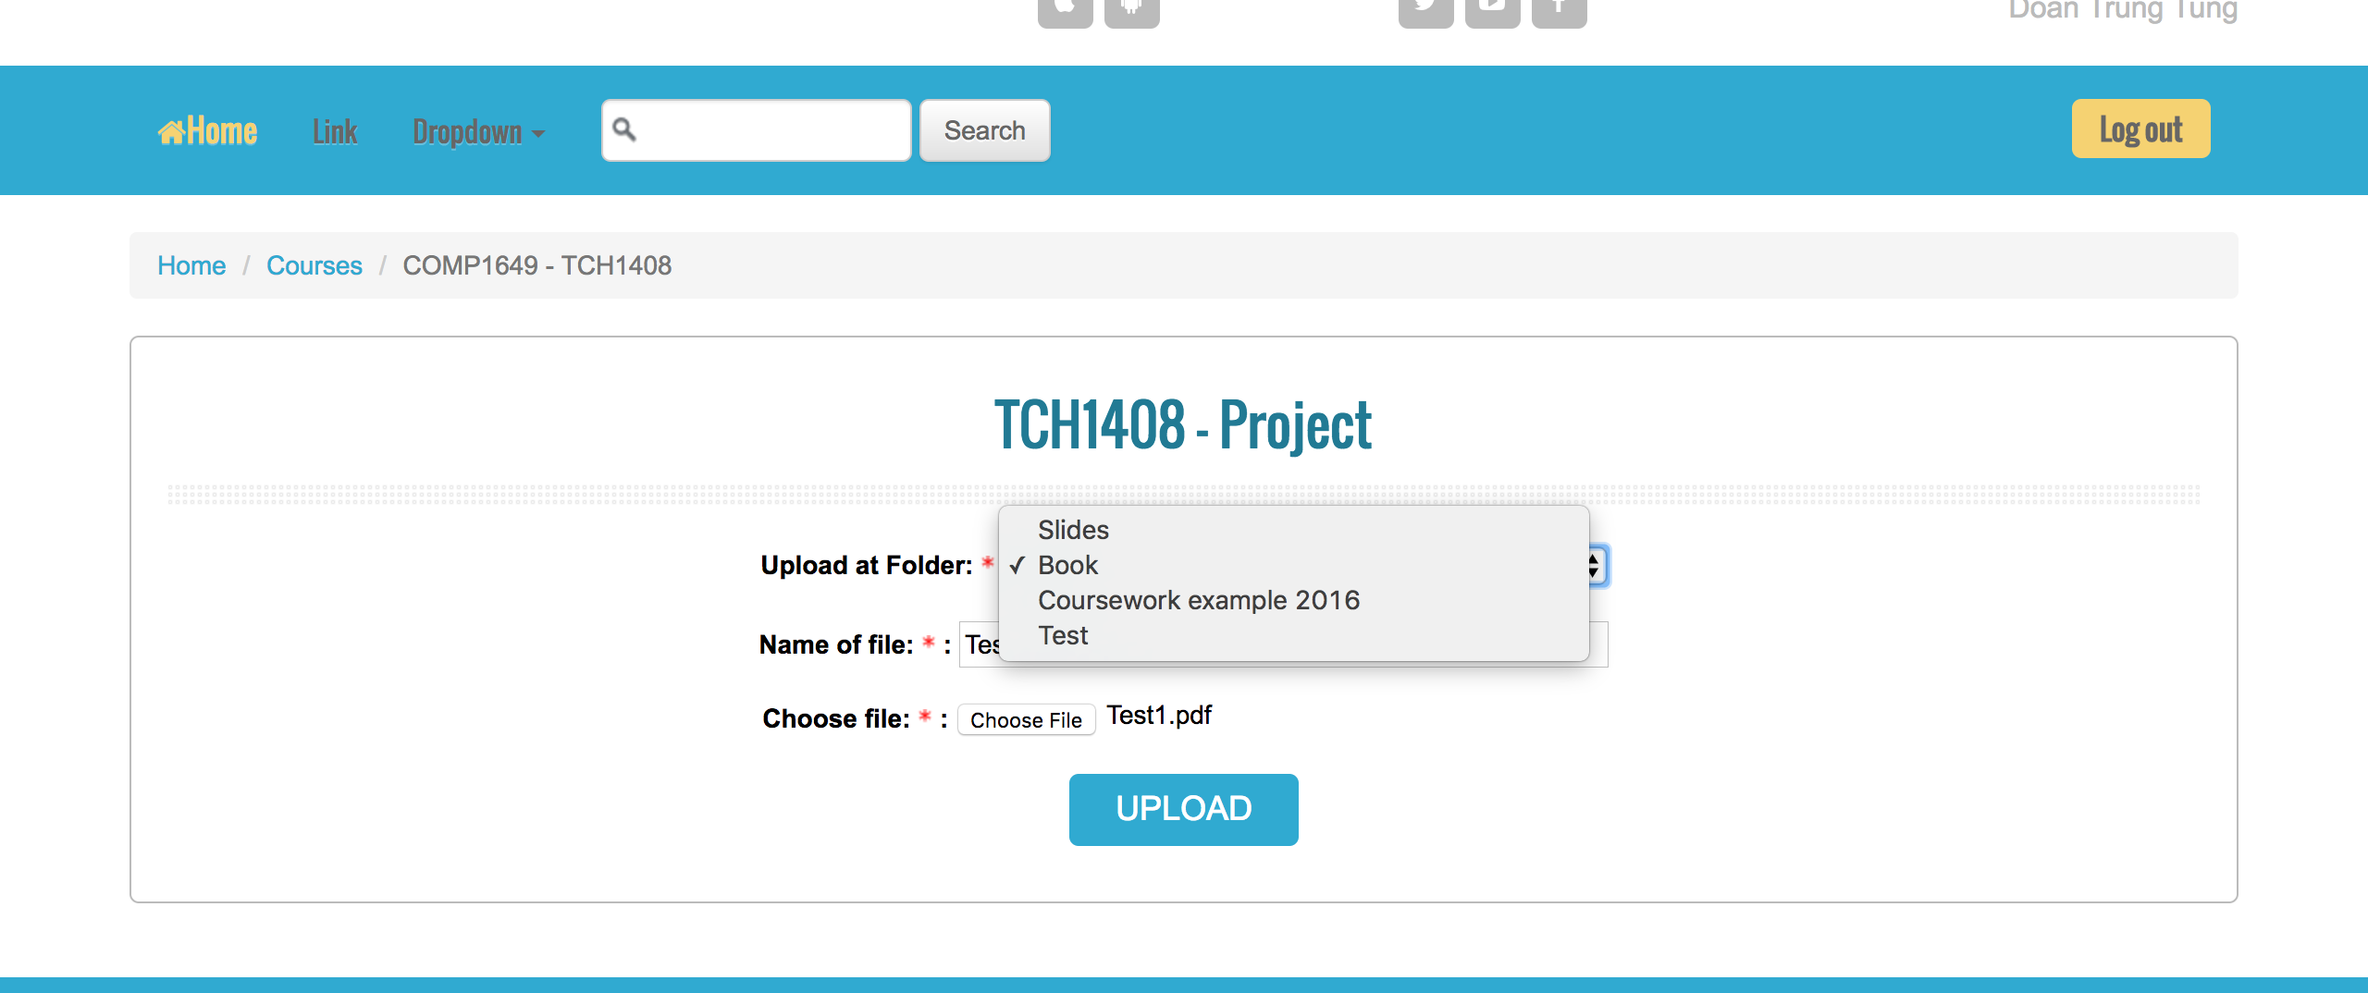
Functionality for each role in the website
As a Teacher
I can upload document for each Section: Book, Coursework Example and Test

Slide 45
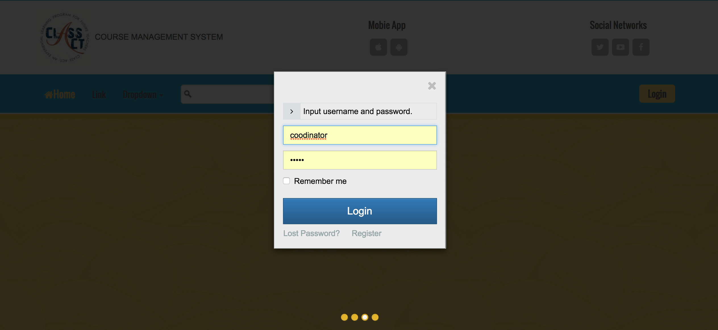
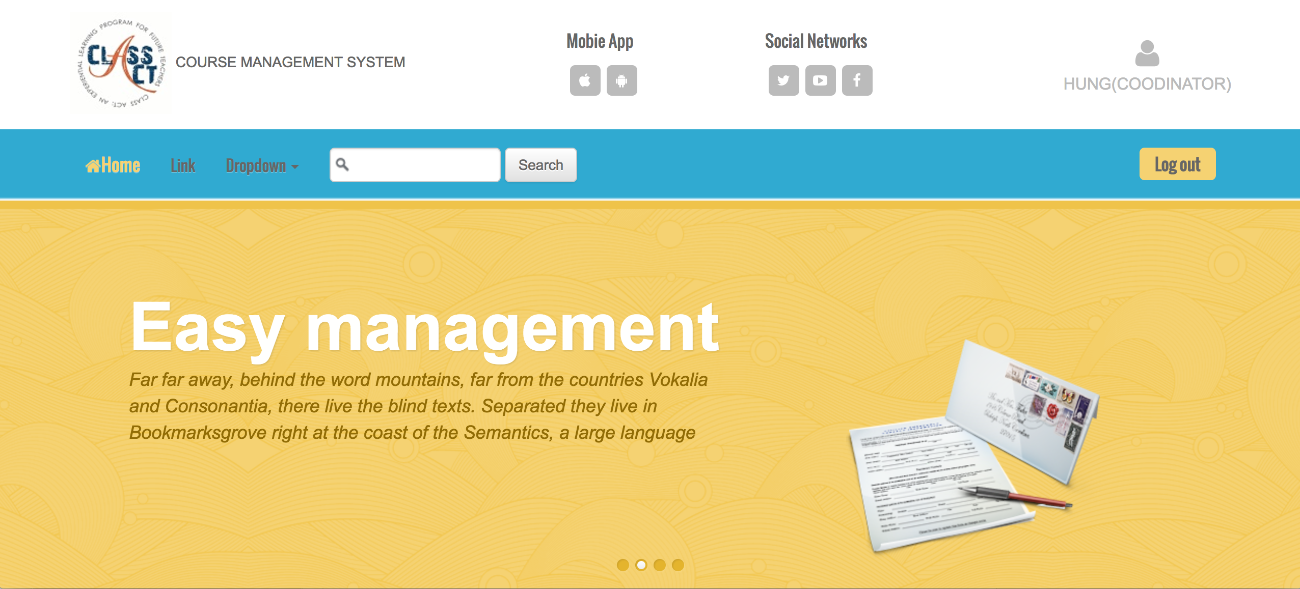
Functionality for each role in the website
As A Coordinator
I can login/logout to system

Slide 46
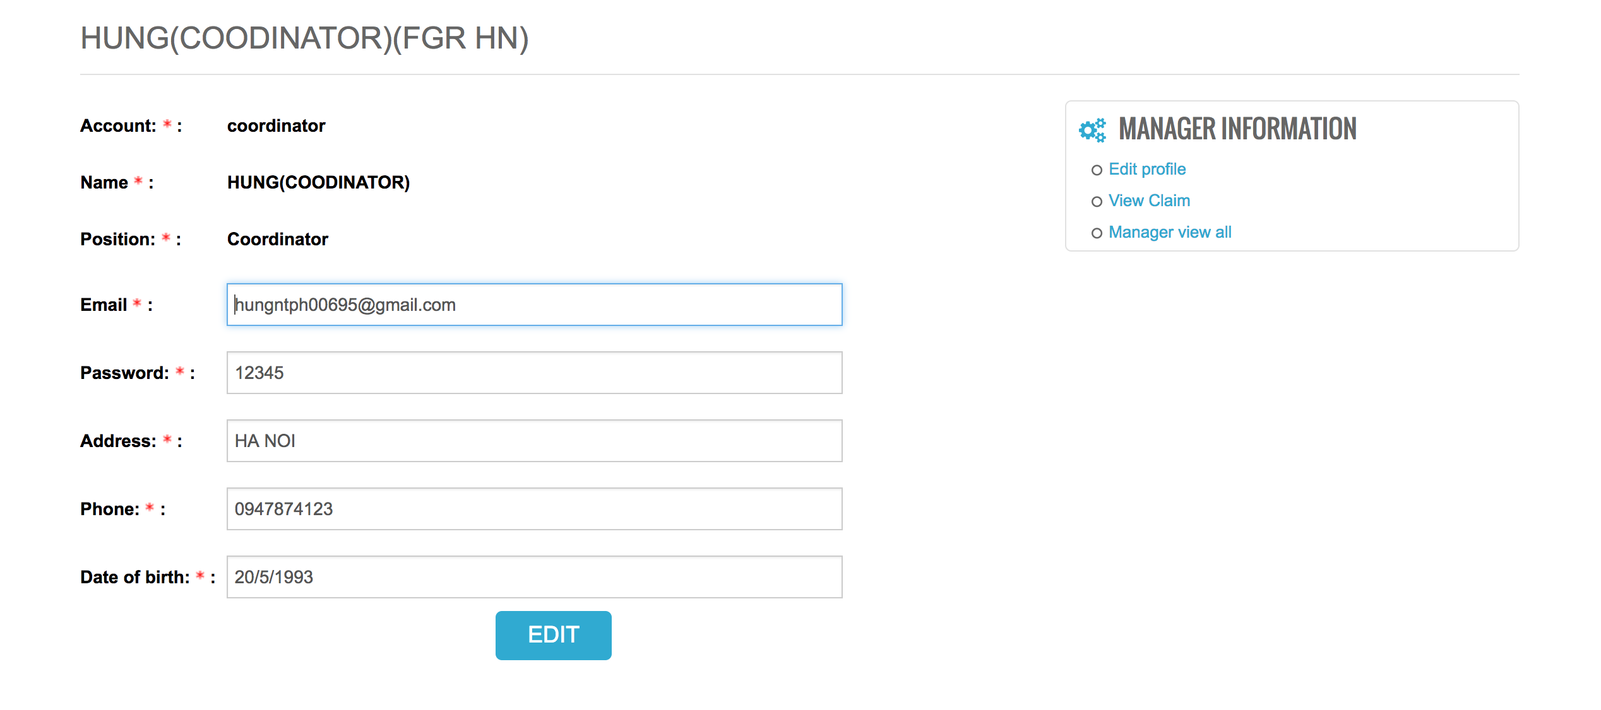
Functionality for each role in the website
As A Coordinator
I can edit the profile

Slide 47
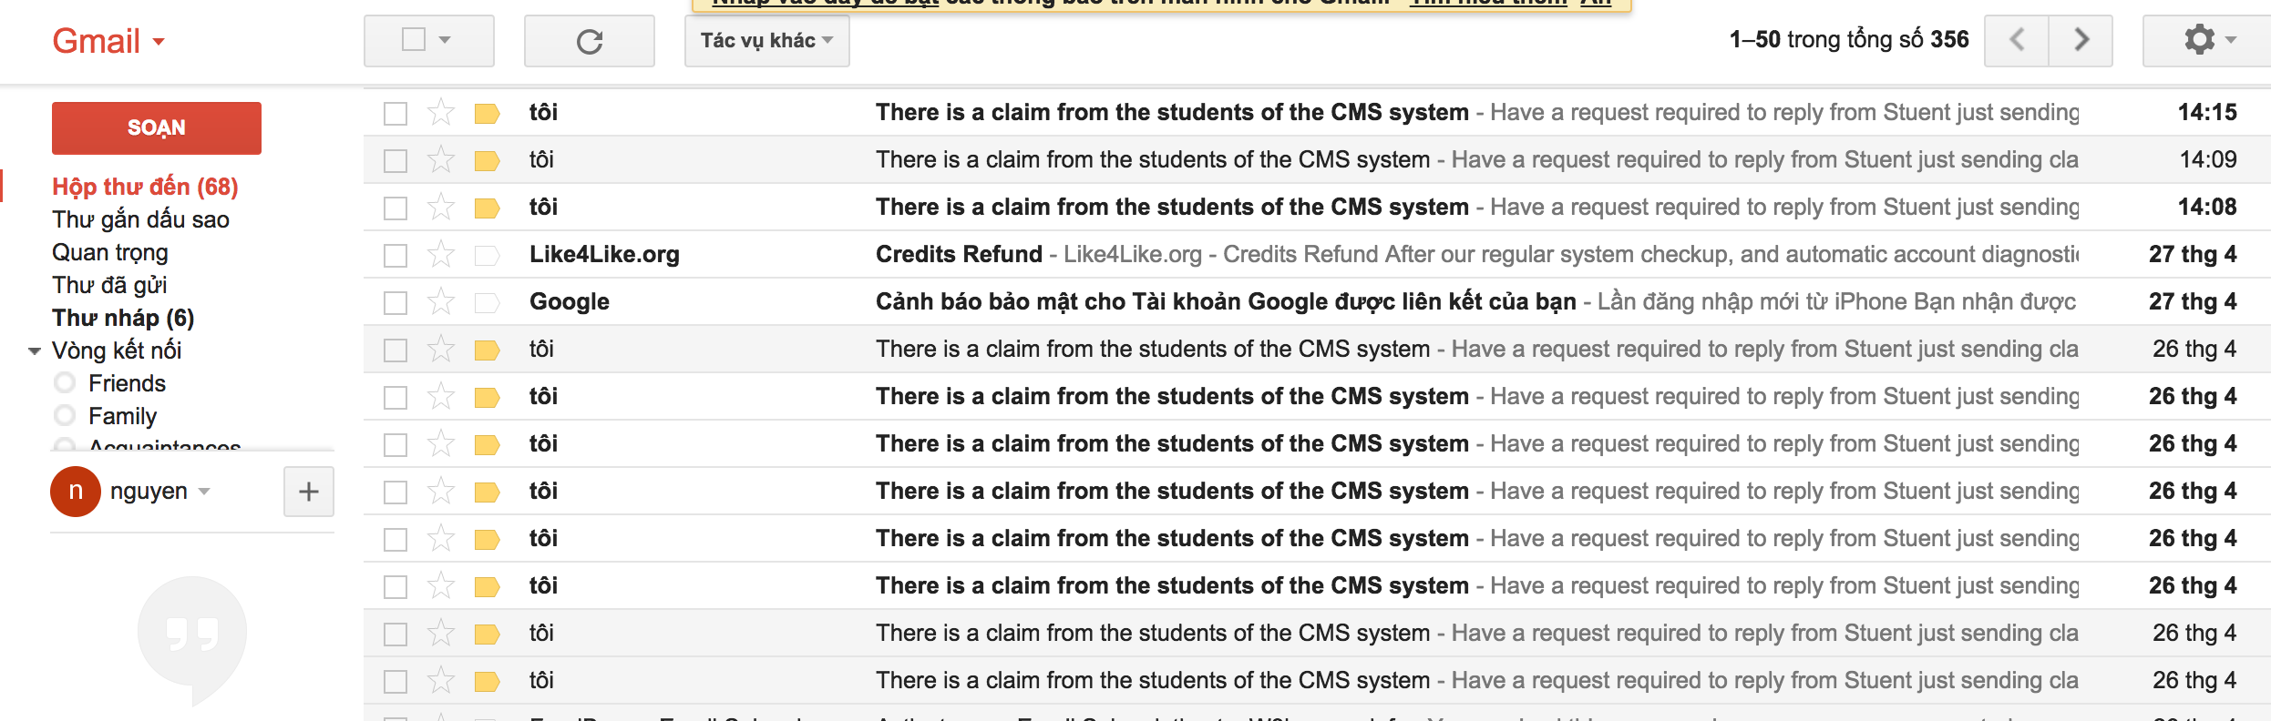
Functionality for each role in the website
As a Coordinator
Get notification from email when student just sent the claim

Slide 48
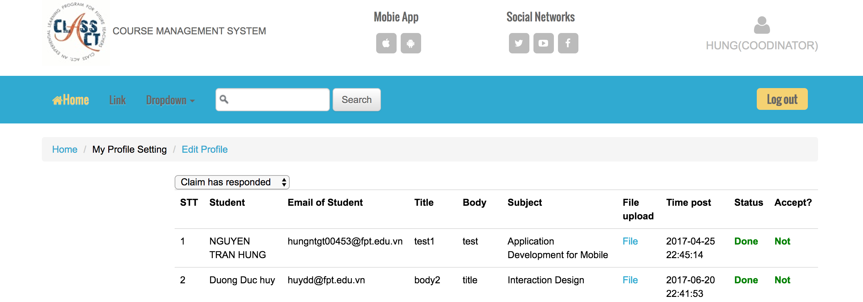
Functionality for each role in the website
As a Coordinator
I can view all the Claims has answered

Slide 49
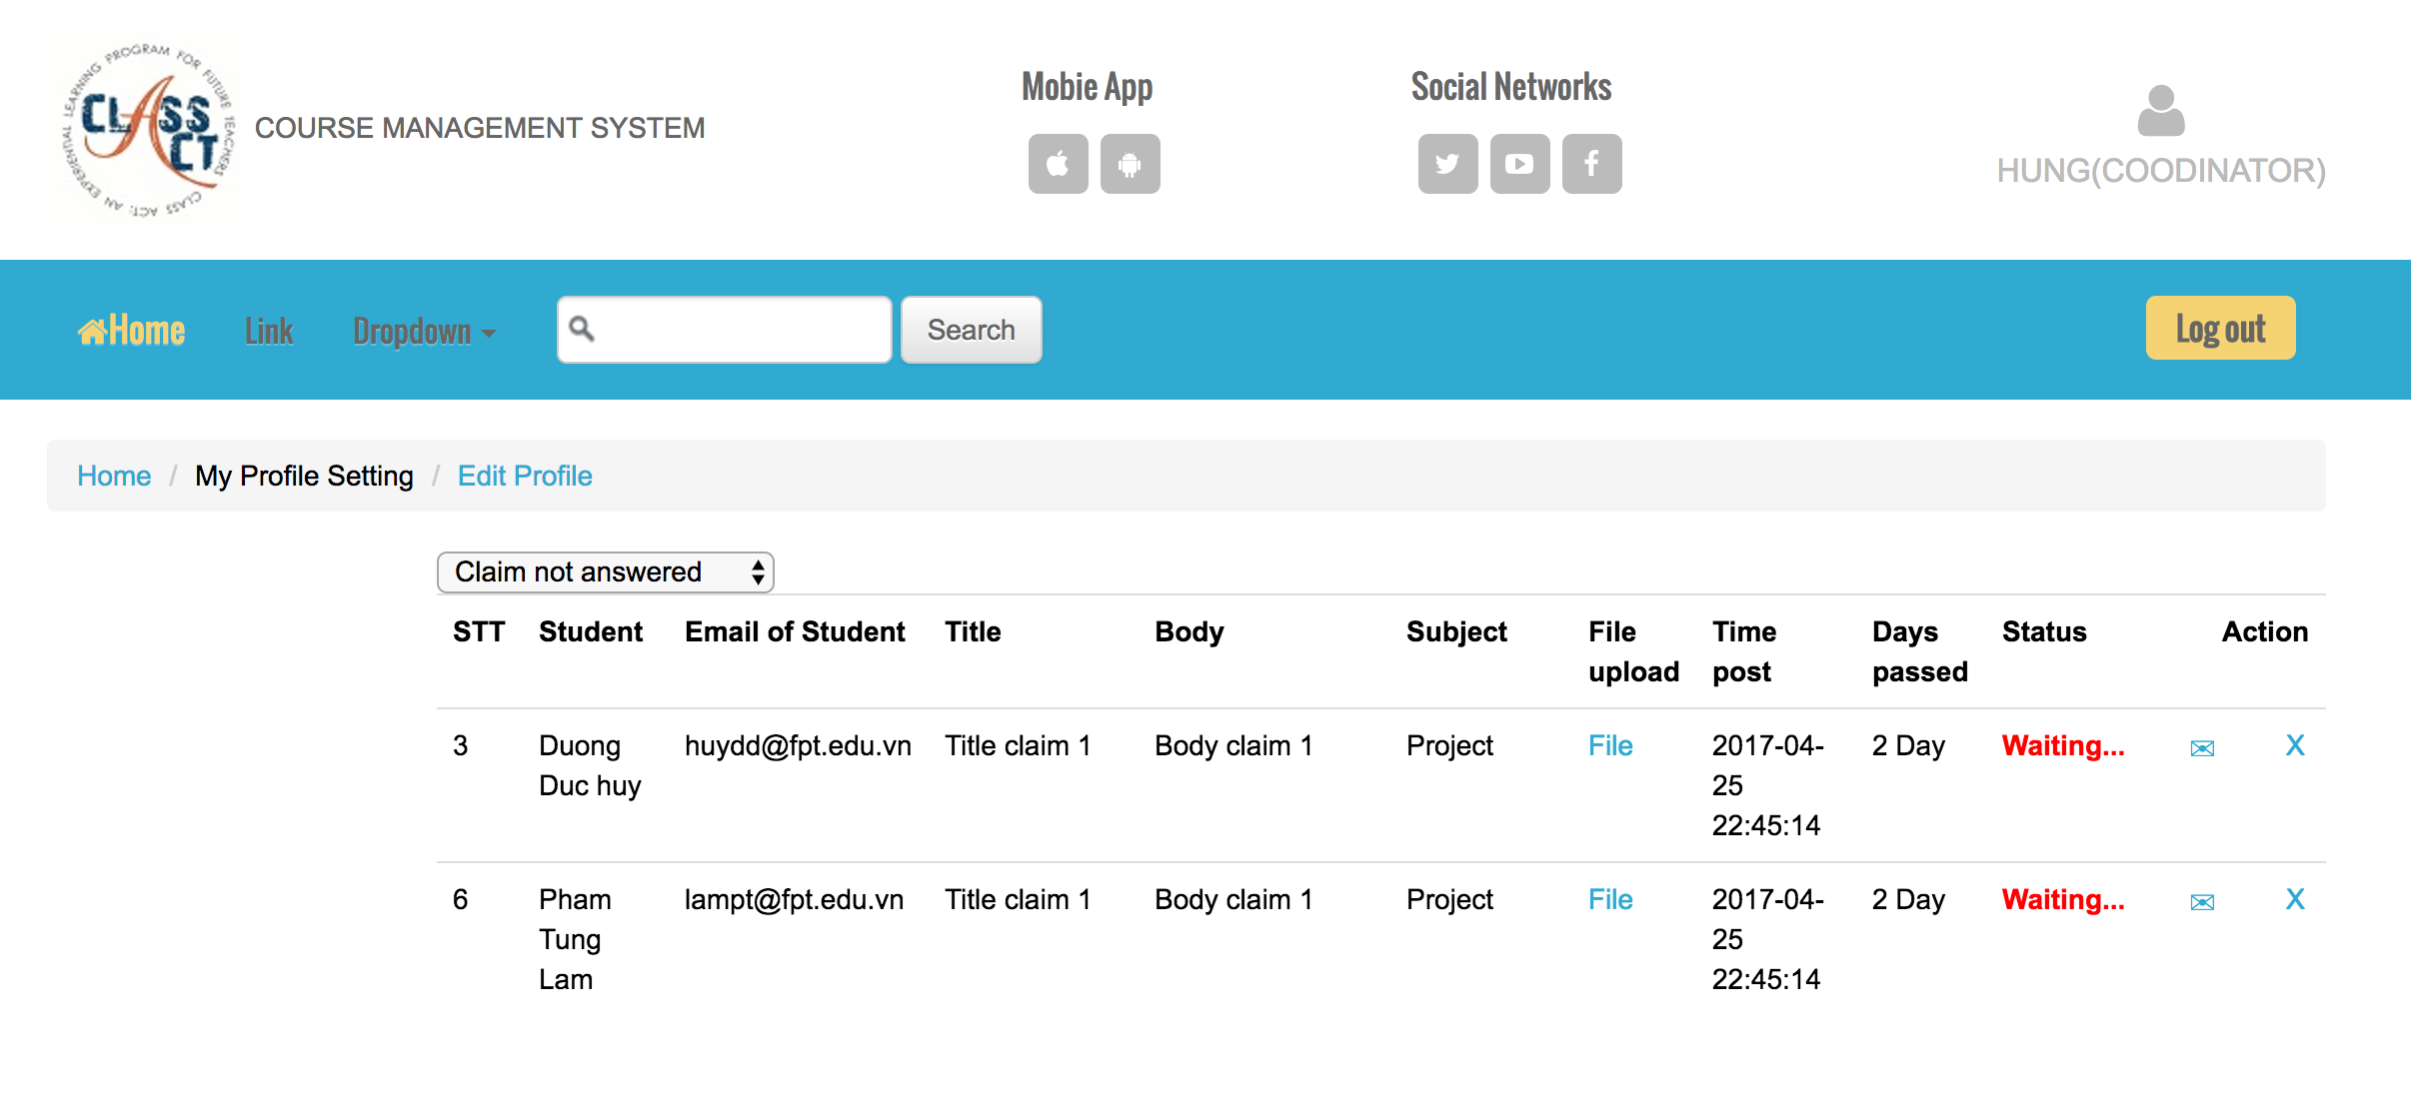
Functionality for each role in the website
As a Coordinator
I can view and handle the claims are not answered

Slide 50
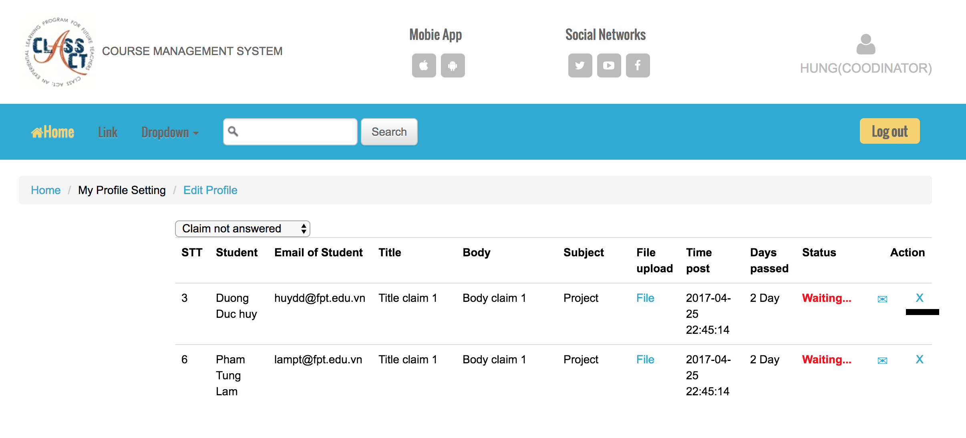
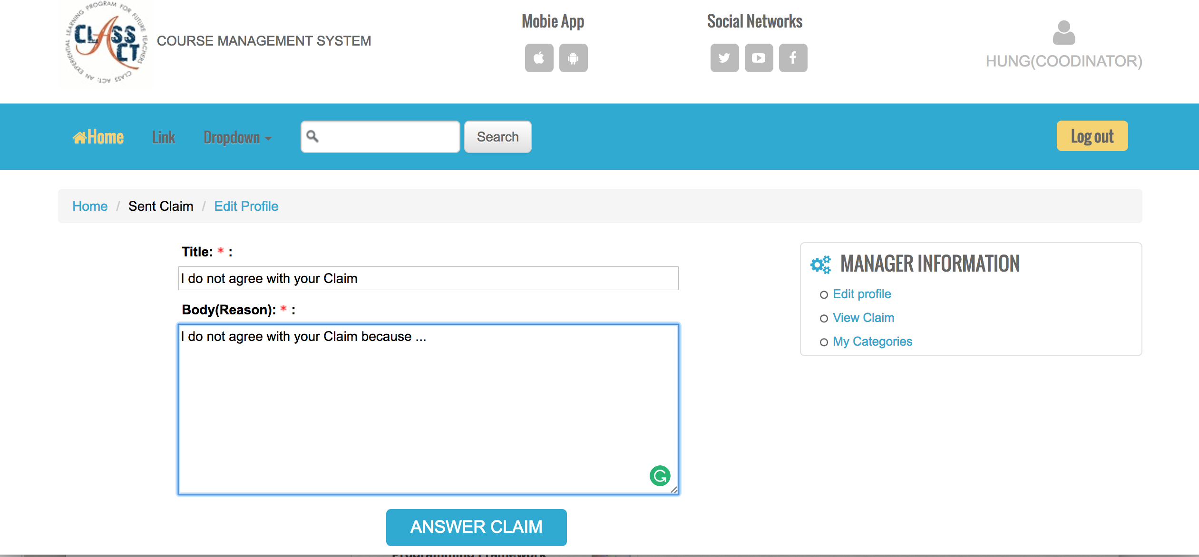
Functionality for each role in the website
As A Coordinator
I can reject the claim by click on X in Action column

Slide 51


Functionality for each role in the website
As A Coordinator
I can answer the claim by click on Mail in Action column

Slide 52

Functionality for each role in the website
As A Coordinator
I can view and handle the claim over 14 days

Slide 53

Functionality for each role in the website
As A Coordinator
I can Add / Update / Delete to manage Semester, Class, Subject, Account, Student learn in each Subject

Slide 54

Functionality for each role in the website
As A Coordinator
Set date time for Subject

Slide 55


Functionality for each role in the website
As A Manager
I can login/logout to system

Slide 56

Functionality for each role in the website
As A Manager
I can edit the profile

Slide 57

Functionality for each role in the website
As A Manager
I can view all the Claims has answered, not answered and over due 14 days but can not process

Slide 58

Functionality for each role in the website
View the chart of statics and comparison

Slide 59

Functionality for each role in the website
View the chart of statics and comparison

Slide 60

Functionality for each role in the website
As A Manager
I can view static of Claims without uploaded evidence and print to download it in PDF by click on PDF

Slide 61

Functionality for each role in the website
As A Manager
I can view static of Claims overdue 14 days and print to download it in PDF by click on PDF

Slide 62
testing
Test log of Functional and Non-functional testing

Slide 63

testing
TEST LOG ON NON-FUNCTIONAL

Slide 64

TESTING
TESTING ON NON-FUNCTIONAL

Slide 65

TESTING
TESTING ON NON-FUNCTIONAL

Slide 66

TESTING
TESTING ON NON-FUNCTIONAL

Slide 67

TESTING
TESTING ON NON-FUNCTIONAL

Slide 68

TESTING
TESTING ON FUNCTIONAL OF STUDENT

Slide 69

TESTING
TESTING ON FUNCTIONAL OF STUDENT

Slide 70

TESTING
TESTING ON FUNCTIONAL OF STUDENT

Slide 71

TESTING
TESTING ON FUNCTIONAL OF STUDENT

Slide 72

TESTING
TESTING ON FUNCTIONAL OF TEACHER

Slide 73

TESTING
TESTING ON FUNCTIONAL OF TEACHER

Slide 74

TESTING
TESTING ON FUNCTIONAL OF COORDINATOR

Slide 75

TESTING
TESTING ON FUNCTIONAL OF COORDINATOR

Slide 76


TESTING
TESTING ON FUNCTIONAL OF COORDINATOR

Slide 77

TESTING
TESTING ON FUNCTIONAL OF MANAGER

Slide 78

Agile methodology
Sprint 1 Product Backlog

Slide 79

Agile methodology
Sprint 2 Product BackLog

Slide 80

Agile methodology
Sprint 3 Product BackLog

Slide 81

Agile methodology
Sprint 4 Product BackLog

Slide 82

Agile methodology
Burn-down chart Sprint 1

Slide 83

Agile methodology
Burn-down chart Sprint 2

Slide 84

Agile methodology
Burn-down chart Sprint 3

Slide 85

Agile methodology
Burn-down chart Sprint 4

Slide 86

Agile methodology
Summary of minute meeting Sprint 1

Slide 87

Agile methodology
Summary of minute meeting Sprint 2

Slide 88

Agile methodology
Summary of minute meeting Sprint 3

Slide 89

Agile methodology
Summary of minute meeting Sprint 4

